Slide 1
Mass Spectrometry Vs. Immunoassay
Ms. Randall
Clinical Chemistry

Slide 2
Guiding Question: Can LC-MS completely replace Immunoassay in the clinical laboratory?
Objectives:
To describe and define the lab techniques of Liquid Chromatography/Mass Spectroscopy & Immunoassay.
To compare and contrast the uses of LC-MS and Immunoassay.
To construct a pro/con table for each technique.

Slide 3
Immunoassays
Purpose: To Identify and quantitate specific antigens in a sample
Chemical tests used to detect or quantify a specific substance, the analyte, in a blood or body fluid sample, using an immunological reaction.
Uses: Cancer markers, diagnosing infectious diseases, cardiac analysis, therapeutic drug monitoring, and allergy testing.
Immunoassay Explained

Slide 4
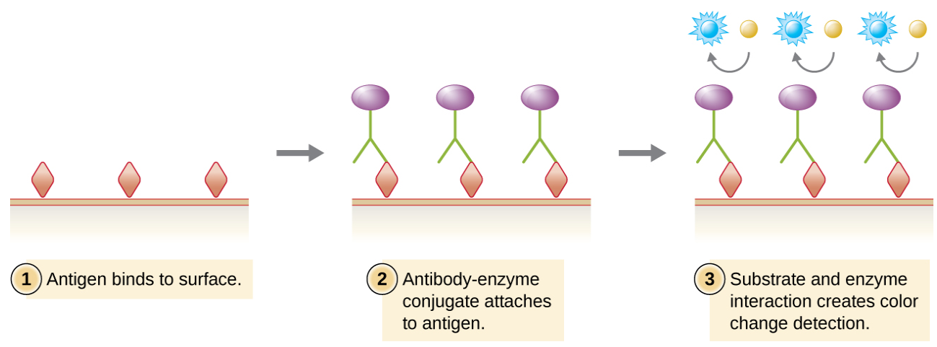
Immunoassays
Technique: Highly sensitive and specific due to the use of antibodies and purified antigens as reagents.
Automated and standardized.
The amount of analyte concentration is obtained as compared to a reference standard curve.

Slide 5
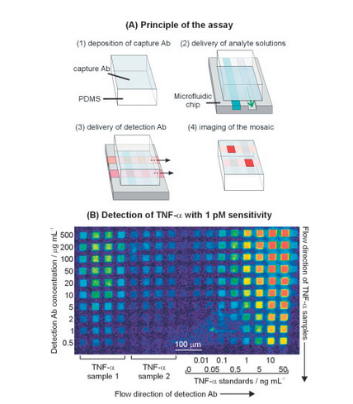

Slide 6
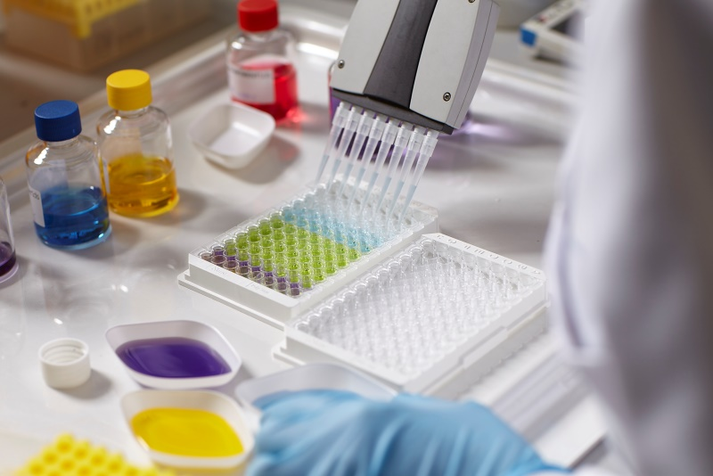
Immunoassays
Advantages:
Well characterized and trusted.
Relatively inexpensive equipment, flexible and scalable(manual to automated).
Training requirements low for basic daily operations.
Good sensitivity and selectivity. (Multiple antigens)

Slide 7
Immunoassays
Disadvantages:
Not all antibody/antigen pairs are readily available or exist or may have low sensitivity(Range limited). Ex:Testosterone
Multi-step process with lot variations limiting inter and intra lab reliability.
Higher cost for reagents and consumables.

Slide 8
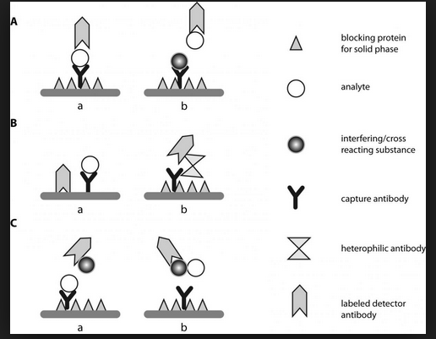
Immunoassays
Disadvantages continued:
Sample volumes can be quite high.
Time consuming due to multiple step process(1-3 hours).
Susceptible to interference.

Slide 9
Liquid Chromatography/ Mass Spectroscopy
Purpose: To Identify and quantitate specific molecules in a sample.
High Performance Liquid chromatography: Separates out analytes in complex mixtures based on size and affinity for
Mass spectrometry: analytes and chemical species in the sample are ionized and the ions separated based on their mass-to-charge ratio and subsequently detected.
Uses: Newborn screening for metabolic diseases, therapeutic drug monitoring, drug of abuse and pain management testing,
Endocrinology and steroid testing.
Mass Spectrometry Explained

Slide 10
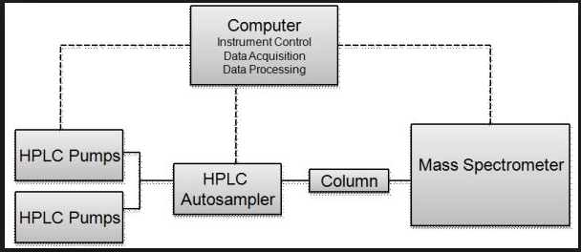
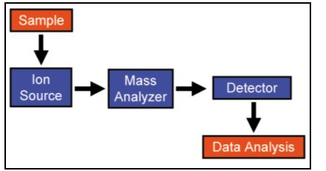
Liquid Chromatography/ Mass Spectroscopy
Technique: Measures mass to charge ratio of a molecule and its ionized fragments.
Assays developed in house.
Used for research as well as clinical assays.

Slide 11
Liquid Chromatography/ Mass Spectroscopy
Advantages:
Extremely high sensitivity and precision for identification and detection of analytes.
Required sample volume extremely small(<5µl) (newborns).
Day to day costs low. Chromatography column and solvents.
Almost completely automated. High precision instruments ensure high Intra and inter assay reproducibility
Wider range of compounds and analytes can be analyzed(proteins).
Flexibility to create new assays.

Slide 12
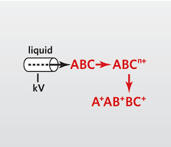
Liquid Chromatography/ Mass Spectroscopy
Advantages continued:
Fast and produces a large number of quantitative and qualitative results. Many analytes can be analyzed at a time for a single LC-MS analysis of a sample.
Not limited to biomolecules and can identify and quantify a wide range of organic and inorganic compounds.
Selectivity in LC is good or easy to optimize compared with immunoassay.

Slide 13
Liquid Chromatography/ Mass Spectroscopy
Disadvantages:
New assay development validation process time consuming and complex.(Paperwork!)
Lack of standardization when using “home grown” assays.
Requires skilled staff and heavy training commitment.

Slide 14
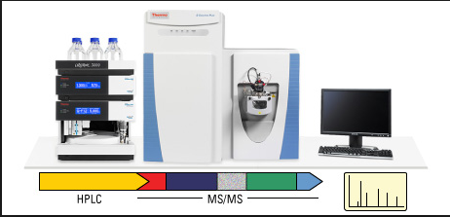
Liquid Chromatography/ Mass Spectroscopy
Disadvantages continued:
High cost of initial investment and maintenance of instrumentation.
Can be difficult to incorporate into core laboratory automation and bidirectional LIS for reporting.
Sample Complexity-plasma has multiple proteins.

Slide 15
Compare & Contrast
Create a pro and con list for each technique

Slide 16
Compare & Contrast

Slide 17
Final thoughts…
Can LC-MS completely replace Immunoassay in the clinical laboratory?
Can the two techniques be combined????

