Slide 1
Lesson 4: Peripheral Nervous System
Objective:
Describe the organization and functions of the sympathetic nervous systems
Describe the organization and functions of the parasympathetic nervous systems
Describe the organization and function of the sensory-somatic nervous system

Slide 2
Peripheral Nervous System
The peripheral nervous system consists of all the nerves and associated cells that are not part of the brain or spinal cord.
Cranial nerves go through openings in the skull and stimulate regions of the head and neck.
Spinal nerves stimulate the rest of the body.
The cell bodies of cranial and spinal nerves are arranged in clusters called ganglia.

Slide 4
Nerve and Nerve Fiber Classification
Sensory nerves
Conduct impulses into brain or spinal cord
Motor nerves
Conduct impulses to muscles or glands
Mixed (both sensory and motor) nerves
Contain both sensory nerve fibers and motor nerve fibers
Most nerves are mixed nerves
ALL spinal nerves are mixed nerves (except the first pair)

Slide 6
Somatic Nervous System
The somatic nervous system regulates body activities that are under conscious control, such as the movement of skeletal muscles.
Most of the time you have control over skeletal muscle movement, but when your body is in danger the central nervous system may take over.

Slide 7
12 Cranial Nerves
The 12 pairs of cranial nerves are responsible for the special senses of smell, sight, and hearing/balance, and control movement of the eye, jaw, face, tongue, and muscles of the neck, back, and shoulders.
They also provide sensation from the face, neck, and upper chest and autonomic innervation to thoracic and abdominopelvic organs.

Slide 8
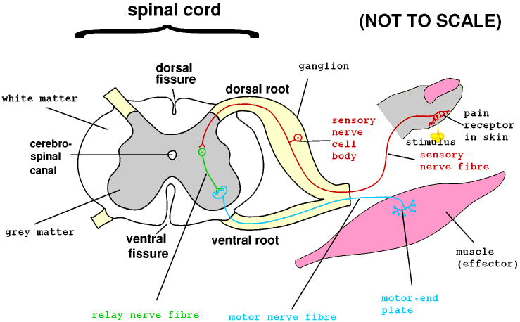
Reflex Arc

Slide 9
Autonomic Nervous System
The autonomic nervous system regulates activities that are involuntary, or not under conscious control.
Controlled largely by CNS
Medulla oblongata regulates cardiac, vasomotor and respiratory activities
Hypothalamus regulates visceral functions, such as body temperature, hunger, thirst, and water and electrolyte balance
Limbic system and cerebral cortex control emotional responses

Slide 10
Autonomic Nervous System
Two autonomic divisions regulate:
Sympathetic division (speeds up)
Prepares body for ‘fight or flight’ situations
Parasympathetic division (pauses or slows down)
Prepares body for ‘resting and digesting’ activities

Slide 11
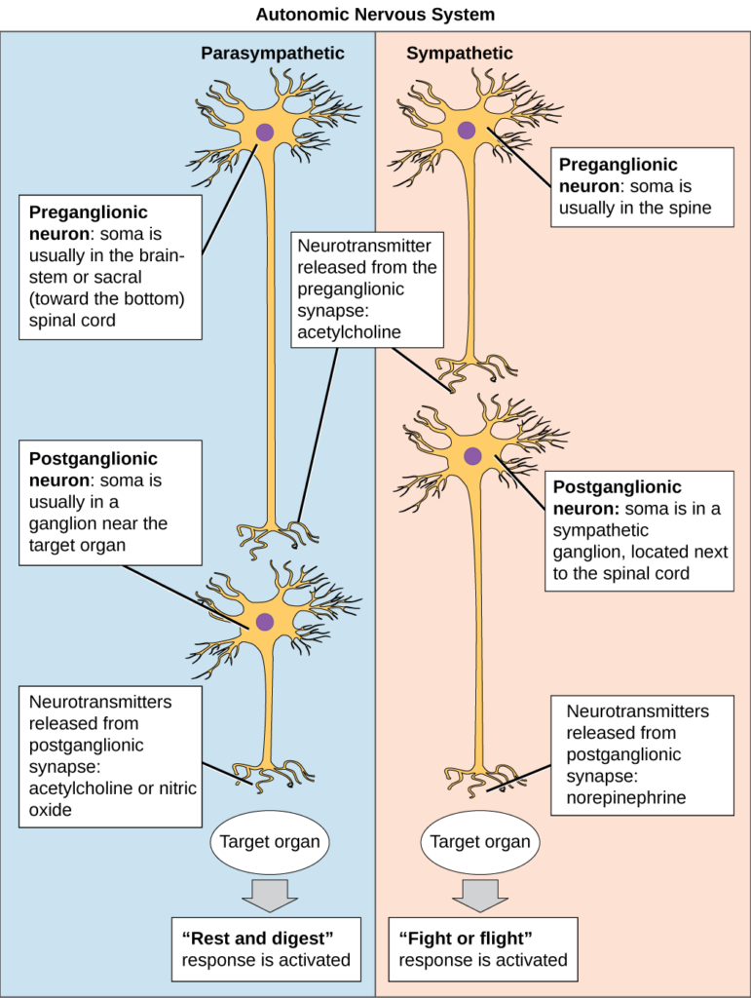

Slide 12
Sympathetic Division
Portion of the autonomic nervous system that produces the “fight or flight” response:
Dilation of pupils
Increased heart and breathing rates
Constriction of blood vessels
Inhibits digestion

Slide 13
Parasympathetic Division
Portion of the autonomic nervous system that produces the “rest and ruminate” response:
Constricts pupils
Dilates blood vessels
Reduces heart and breathing rates.
Stimulates digestion.

Slide 14
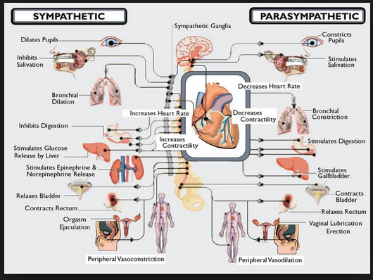

Slide 15
Lesson 5: Reflex Arcs
Objective:
To describe the function of each part of a reflex arc
To explain two reflex examples

Slide 16
Reflexes
Rapid, predictable, involuntary responses to stimuli
Somatic Reflexes: stimulate skeletal muscles
jerking away hand from hot object
Autonomic Reflexes: regulate smooth muscles, heart, glands
salivation, digestion, blood pressure, sweating

Slide 17
Reflex Arc (neural pathway)
Five elements:
Receptor – reacts to stimulus
Sensory neuron
CNS integration center
Motor neuron
Effector organ – muscle or gland

Slide 19
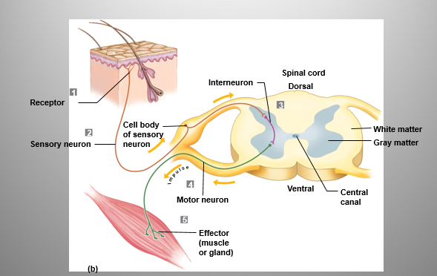

Slide 21
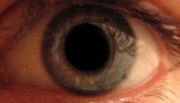
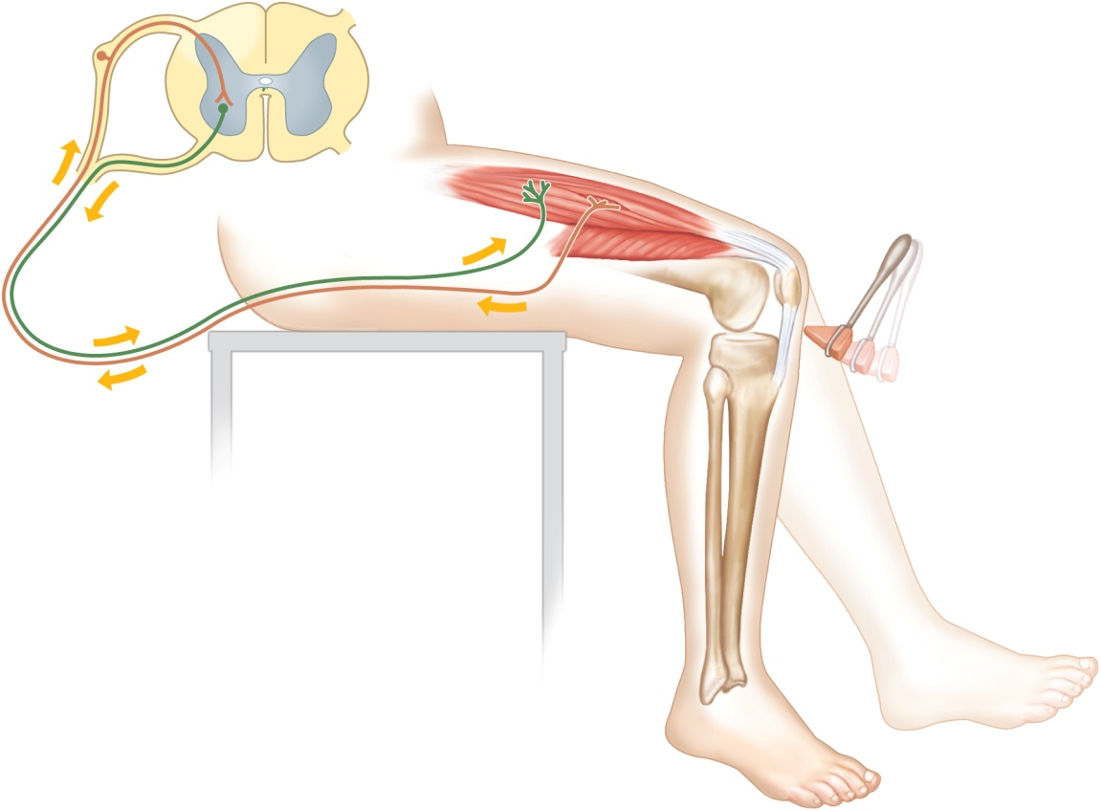
Patellar (Knee-jerk) Reflex
Pupillary Reflex
Stretch reflex
Tapping patellar ligament causes quadriceps to contract → knee extends
Help maintain muscle tone, posture, & balance
Optic nerve → brain stem → muscles constrict pupil
Useful for checking brain stem function and drug use

Slide 22
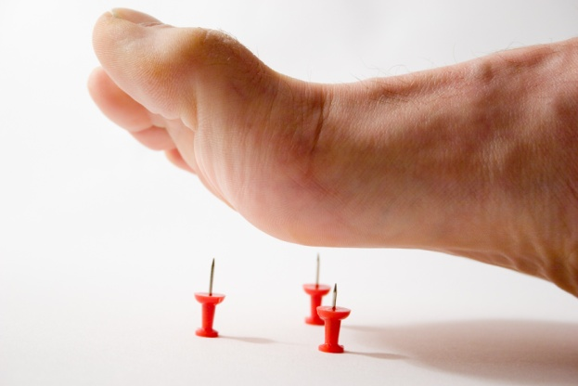
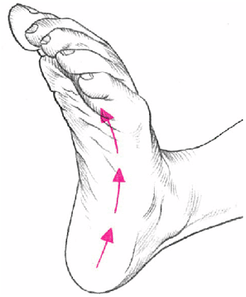
Flexor (withdrawal) reflex:
painful stimulus → withdrawal of threatened body part
Pin prick
Plantar reflex:
draw object down sole of foot → curling of toes
Babinski’s sign: check to see if motor cortex or corticospinal tract is damaged

Slide 23
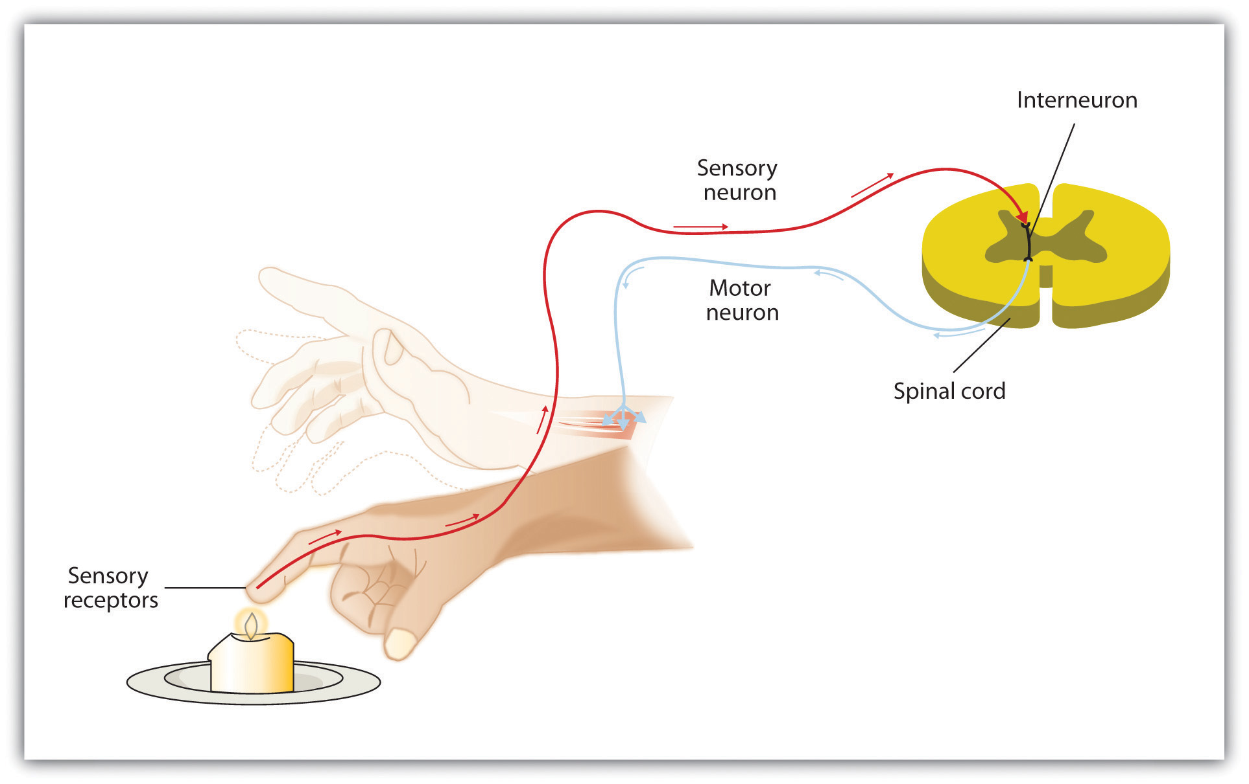
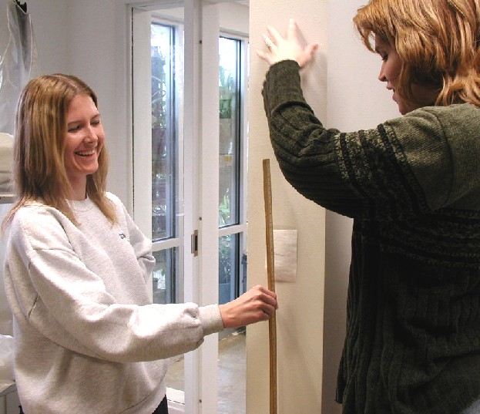
Voluntary Reactions
More neurons and synapses are involved → longer response times
Reflex = Involuntary Reaction
Voluntary Reaction

