Slide 1
Lesson 3: Central Nervous System
Objective:
Identify the components of the central nervous system
Identify locations and basic function of the different parts of the brain
Identify locations and basic function of the different parts of the spinal cord

Slide 2
Central Nervous System
Consists of brain and spine
Functions:
Receives sensory signals and determines appropriate response
Stores memory
Carries out thought

Slide 3
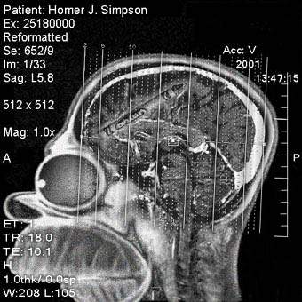
Why a Brain?
Brains are the result of selection for centralization of the nervous system.
Neurons control movement. The brain (or spine) interprets sensory signals and determines the appropriate movements (that is, behavior).
Appropriate movement is critical to the survival of most animal species.

Slide 4
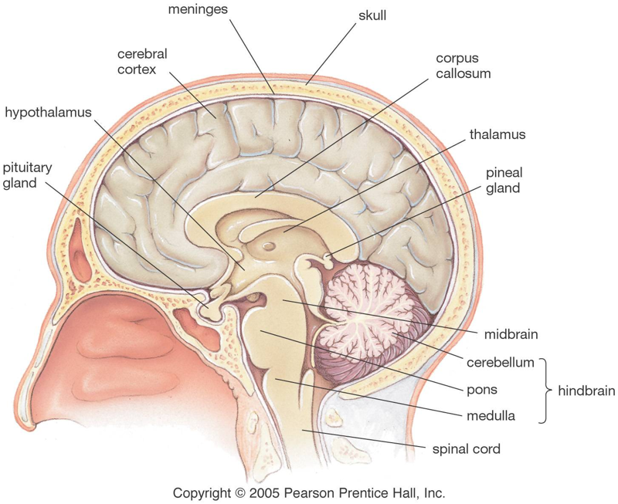
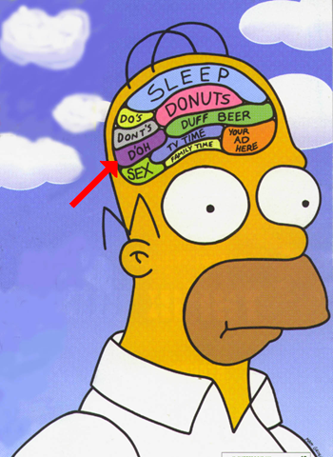
Brain: Structure
Hindbrain carries out the most basic functions.
Midbrain coordinates signals.
Forebrain processes signals, stores memories, creates thought.

Slide 5
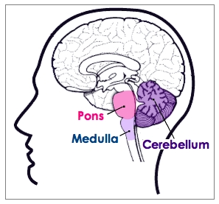
Hindbrain
Medulla: controls autonomic functions.
Pons: controls sleep stages.
Cerebellum: coordinates movement, stores some motor memory.

Slide 6
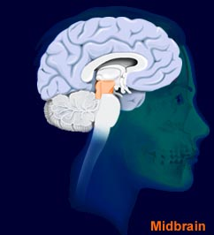
Midbrain
Reticular formation: the “traffic cops” of the brain.
Filters sensory input, which allows us to concentrate.
Filtering can be affected by higher thoughts.

Slide 7
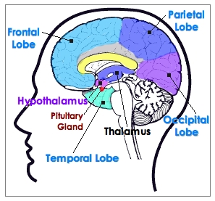
Forebrain
Thalamus: relay station channeling sensory information.
Limbic system: basic emotions, drives, and behaviors.
Cortex: higher thought

Slide 8
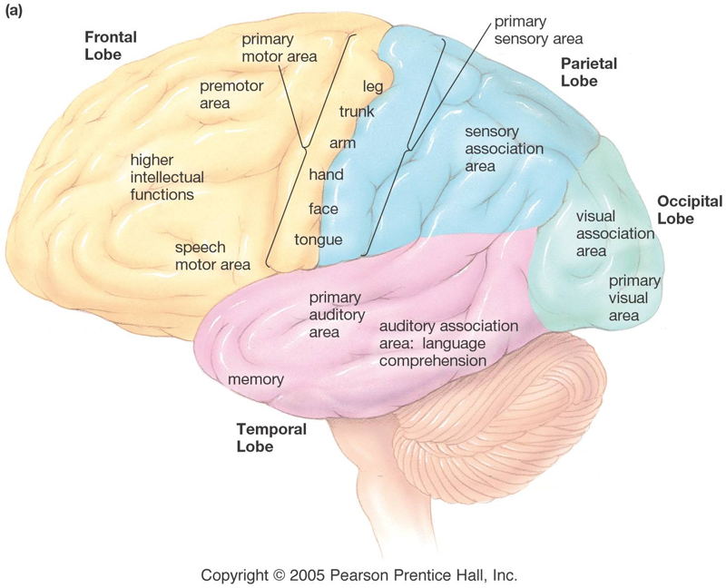
Cortex
Various areas control sensory processing, motor control, thought, memory.
Wiring is plastic: people blind from birth, for example, use parts of the visual cortex to process auditory signals.

Slide 9
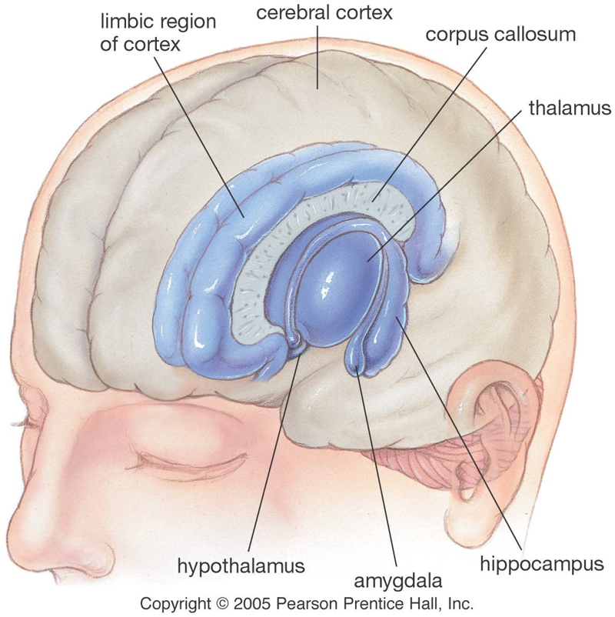
Limbic system
Hypothalamus: master controller of the endocrine system.
Amygdala: sensations of pleasure or fear, recognition of fear in others.
Hippocampus: formation of memories.

Slide 10
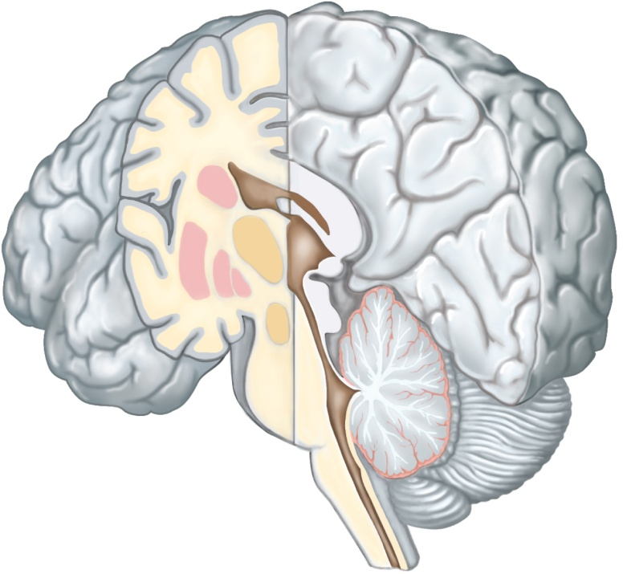
Basal Nuclei
Masses of gray matter
Deep within cerebral hemispheres
Produce dopamine
Control certain muscular activities
Primarily by inhibiting motor functions
Copyright © The McGraw-Hill Companies, Inc. Permission required for reproduction or display.
Longitudinal
fissure
Caudate
nucleus
Right cerebral
hemisphere
Basal
nuclei
Putamen
Globus
pallidus
Thalamus
Cerebellum
Hypothalamus
Brainstem
Spinal cord

Slide 11
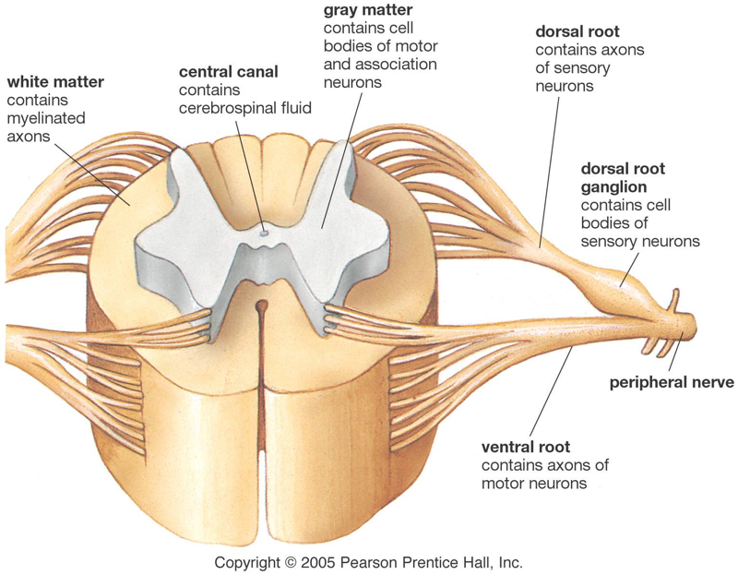
Spine
The spinal cord is protected by the vertebrae.
Gray matter contains cell bodies; white matter contains myelinated fibers.
PNS nerves extend outside of the vertebrae.

Slide 12
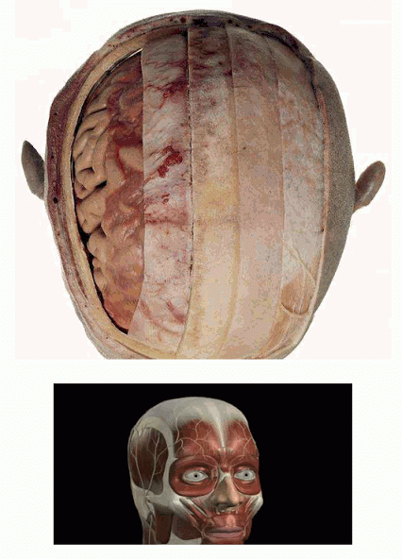
The Meninges
Membranes of CNS
Protect the CNS
Three (3) layers:
Dura mater
“Tough mother”
Venous sinuses
Arachnoid mater
“Spider mother”
Space contains cerebrospinal fluid (CSF)
Pia mater
“Little mother” Encapsulates blood vessels

Slide 13
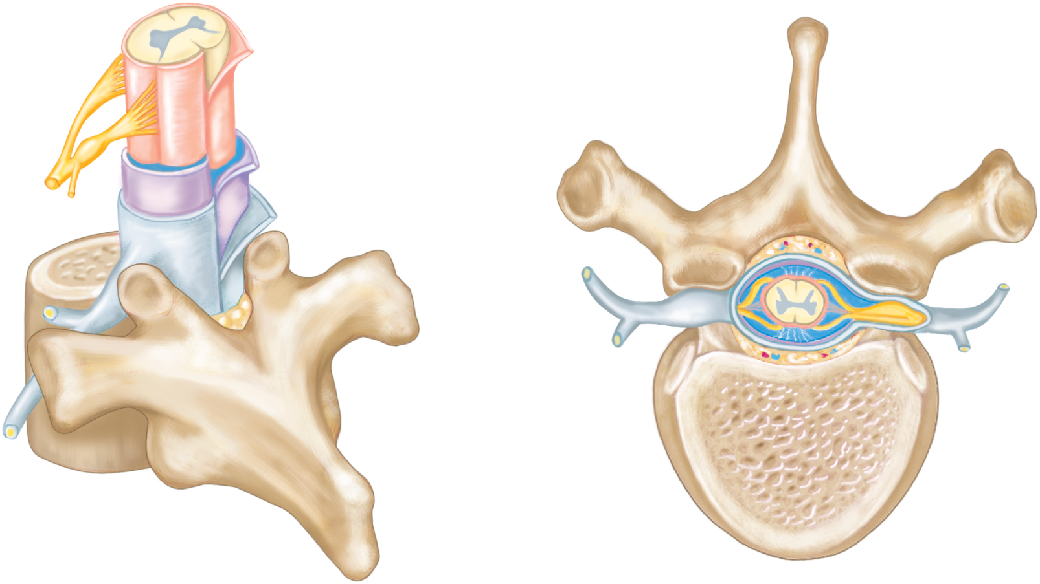
Meninges of the Spinal Cord
Spinal cord
Ventral root
Subarachnoid
space
Dorsal root
Pia mater
Spinal nerve
Arachnoid mater
Dorsal root
ganglion
Dura mater
Epidural space
Dorsal root
Spinal
nerve
Dorsal branch
(dorsal ramus)
Dorsal root
ganglion
Ventral branch
(ventral ramus)
Spinal cord
Ventral root
Epidural
space
Thoracic
vertebra
Body of
vertebra
(a)
(b)

Slide 14
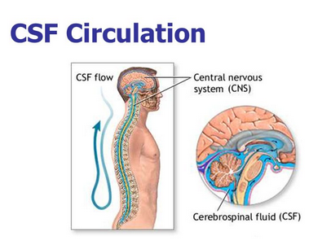
Cerebrospinal Fluid
Circulates continuously
Serves as shock absorber to protect brain and spinal cord
Carries nutrients to parts of brain and spinal cord
Helps remove metabolic products & wastes
After circulation, absorbed into the blood vessels of the dura mater.

