Slide 1
Genetics and Interitance
Ms. Randall

Slide 2
Lesson 1: Mendel and the Pea
Objective: To describe how Mendel studied inheritance of peas and his conclusions. To describe how Punnett squares are used by geneticists as probability of inheritance.

Slide 3
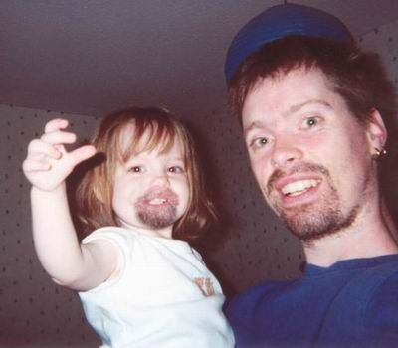
Genetics: Study of heredity
Heredity: Passing of genetic information from an organism to it’s offspring.

Slide 4
Mendel
1800’s
“Father of Genetics”
Pea plants: easy to grow
Contrasting traits
Easily self and cross pollinate.
From his studies, Mendel arrived at conclusions that are the basis for genetics today!
How Mendel's pea plants helped us understand genetics

Slide 5
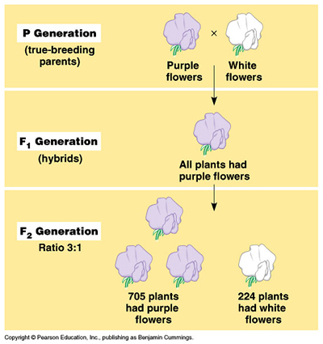
Mendel’s Model:
3 steps
a. Mendel self-pollinate to make a pure breed (P generation)
b. Cross pollinate to create a hybrid (F₁ generation)
c. Self-pollinate again (F₂ generation)

Slide 6
Conclusions:
Model showed that pea plants receive 2 alleles for each trait.
An allele is a different form of a gene.
Genes are pieces of genetic information about traits.
A strong allele is called a dominant allele.
A weak allele is called a recessive allele.

Slide 7
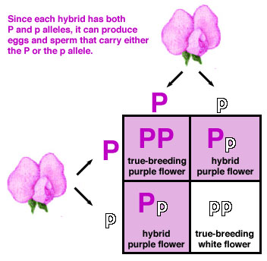
Inheritance-How do we predict traits in offspring?
A Punnett square is a mathematical model for predicting traits in pea plants.
Predict the probability that an offspring will receive a trait from a parent.

Slide 8
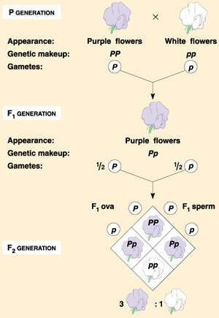
Offspring that inherit the same allele from each parent are called homozygous for that trait.
Offspring that inherit different alleles for the same trait are called heterozygous for that trait. Genes and traits
Appearance of an organism-phenotype
Set of genes that an organism has-genotype

Slide 9
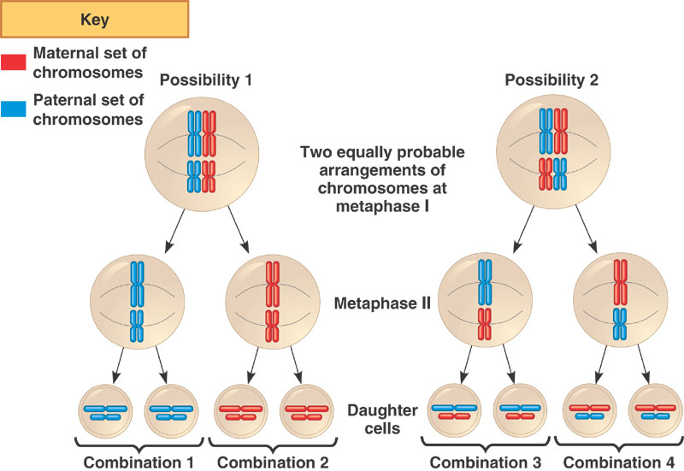
Mendel's observations from these experiments can be summarized in two principles:
Principle of segregation
  For any particular trait, the pair of alleles of each parent separate and only one allele passes from each parent on to an offspring.
  Which allele in a parent's pair of alleles is inherited is a matter of chance. We now know that this segregation of alleles occurs during the process of meiosis ( gamete formation )

Slide 10
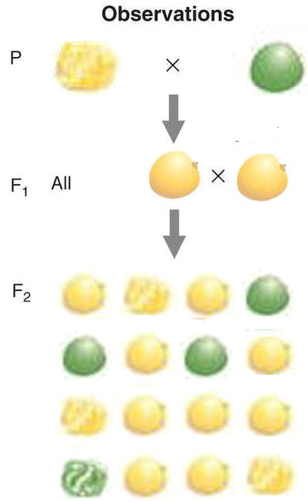
Mendel's observations from these experiments can be summarized in two principles:
Principle of Independent Assortment
  Different pairs of alleles are passed to offspring independently of each other.
  The result is that new combinations of genes present in neither parent are possible.

Slide 11
Check your understanding

Slide 12
Lesson 2: Pedigrees Karyotypes and Genetic Counseling
Objective: Describe how pedigrees and karyotypes are used by geneticists for predicting probability of inheritance.

Slide 13
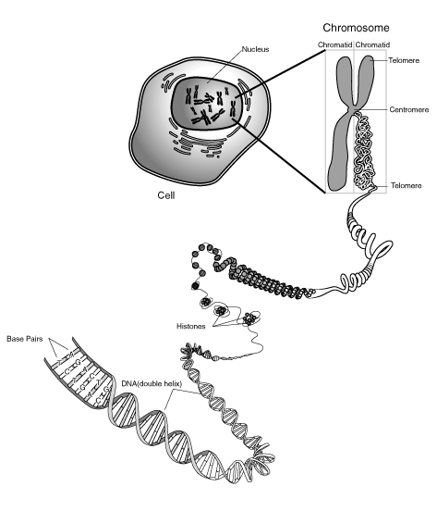
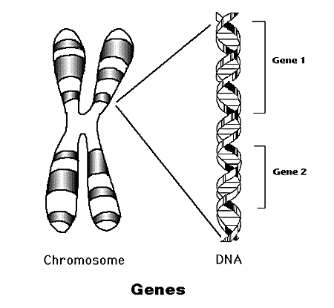
DNA Replication

Slide 14
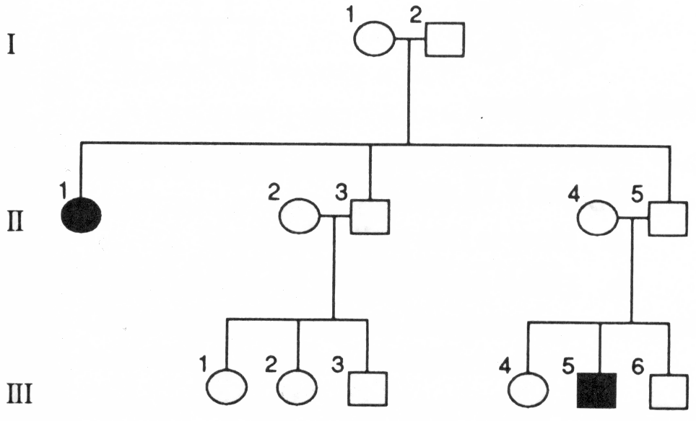
Human heredity
Studied through pedigree charts
Can you determine genotypes for the above individuals?

Slide 15
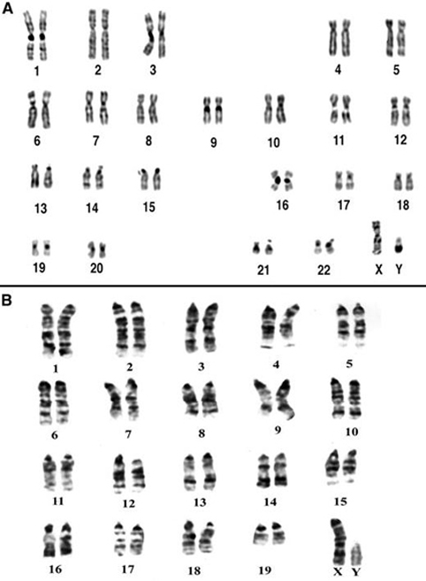
Determining Disorders
    Karyotyping: mitosis is photographed, enlarged and the chromosomes are arranged in pairs

Slide 16
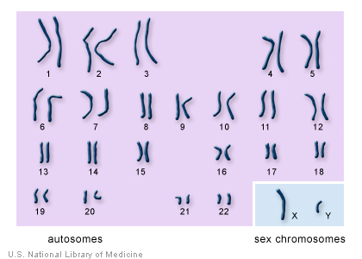
Chromosomes and Cell Reproduction
Autosomes – chromosomes that are not directly involved in determining sex.
Sex Chromosomes - chromosomes that are involved in determining the sex of an individual. In humans the 23rd pair. XX (female) XY (male).

Slide 17
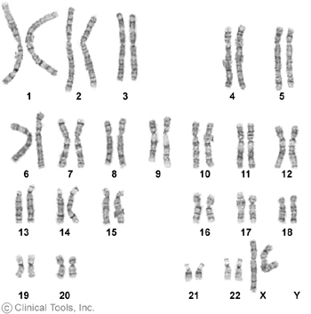
Karyotypes
Normal Female

Slide 18
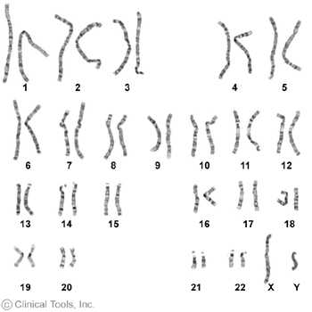
Karyotypes
Normal Male

Slide 19
Chromosomal disorders
  Down Syndrome: trisomy 21 where an extra copy of #21 exists due to non-disjunction
  Klinefelter syndrome: 2X and 1Y, thus a male results, though with underdeveloped sex organs
  Turner syndrome: only 1X, thus a female results, though with underdeveloped sex characteristics

Slide 20
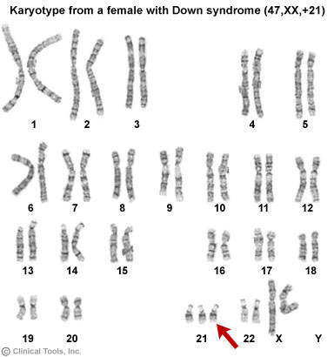
Down syndrome

Slide 21
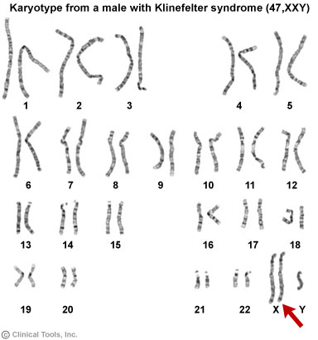
Klinefelter Syndrome
Affected males are almost always effectively sterile.
In adults, possible characteristics vary widely and include little to no signs of affectedness, a lanky, youthful build and facial appearance, or a rounded body type with some degree of gynecomastia (increased breast tissue).

Slide 22
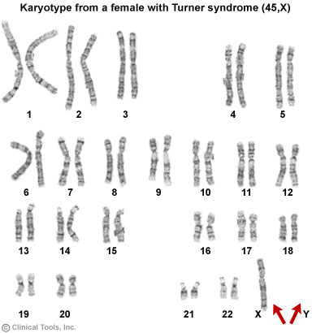
Turner Syndrome
Symptoms
Short stature
Lymphoedema (swelling) of the hands and feet
Broad chest (shield chest) and widely-spaced nipples
Low hairline
Low-set ears
Reproductive sterility
Amenorrhea, or the absence of a menstrual period
increased weight, obesity

Slide 23
Check your understanding

Slide 24
Lesson 3: DNA
Objective: To describe the overall structure of DNA and summarize the events of DNA replication

Slide 25
DNA and RNA
DNA-Deoxyribonucleic acid: found in the nucleus
RNA-ribonucleic acid: found in the cytoplasm
  DNA is the genetic material was confirmed by Hershey and Chase when they studied a virus reproducing in bacteria and passing genetic material to offspring

Slide 26
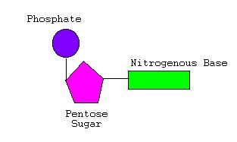
  Both are made of Nucleotides.
  Nucleotides contain a phosphate group, a sugar (deoxyribose/ribose) and a base
      4 possible bases used in DNA
        A= adenine
        G=guanine
        C=cytosine
        T=thymine(U=uracil in RNA)

Slide 27
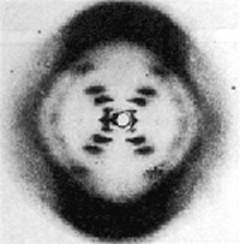
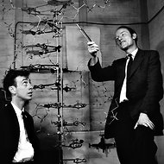
DNA-Watson and Crick
Determined the shape of DNA to be a double helix that is connected by bases (like a ladder)
  Only possible bond types were A-T and C-G
  Weak hydrogen bonds hold them together
  The strands are complimentary
A G C C T T A
T C G G A A T

Slide 28
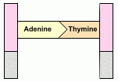
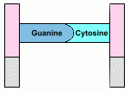
Base Pairing
Adenine (A) pairs with Thymine (T)
Cytosine (C) pairs with Guanine (G)
( Complementary base pairs).
Held together by relatively weak hydrogen bonds

Slide 29
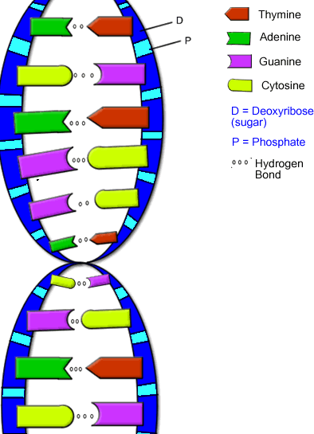

Slide 30
DNA Replication
occurs in the nucleus
  Weak hydrogen bonds that hold the base pairs together will break
  Strands will pull apart (can occur at many parts along the DNA) like a zipper
  Free nucleotides will attach to a complimentary base on an open strand
  2 new DNA molecules identical to the original will result

Slide 31
Genetics Can Tell All
G-Guanine
C-Cytosine
T-Thymine
A-Adenine

Slide 32
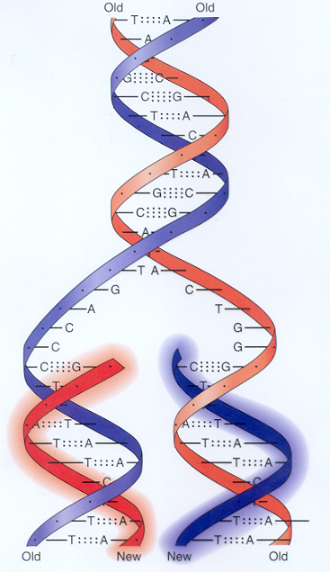
DNA Replication

Slide 33
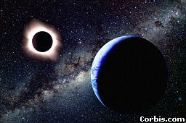
DNA Fun Facts!!!!
Each cell has about 2 m of DNA.
The average human has 75 trillion cells.
The average human has enough DNA to go from the earth to the sun more than 400 times.
DNA has a diameter of only 0.000000002 m.
The earth is 150 billion m
or 93 million miles from
the sun.

Slide 34
Check your understanding

Slide 35
Lesson 4: Protein synthesis
Objective: Describe the process and products of transcription and translation

Slide 36
DNA and proteins
DNA carr­ies all of the information for your physical characteristics, which are essentially determined by proteins.
DNA contains the instructions for making a protein.
In DNA, each protein is encoded by a gene

Slide 37
The “Central Dogma”
How do we move information from
DNA to proteins?
transcription
translation
DNA
RNA
protein
For
simplicity sake,
let’s go back to
genes that code
for proteins…
replication

Slide 38
Transcription
DNA is used as a template to make mRNA (the messenger)
Occurs in the nucleus
4 bases of RNA: Adenine (A), Uracil (U), Guanine (G) and Cytosine (C)
DNA RNA
A U
T A
C G
G C
mRNA leaves the nucleus and travels to the ribosome of the cell.

Slide 39
Translation
(Protein Synthesis)
At the ribosome, mRNA is used to synthesize a protein.
Proteins are made up of a chain of amino acids.
Transfer RNA molecules (tRNA) bring the amino acids to the ribosome.
The anticodon of the tRNA pairs up with the codon (3 bases) of mRNA.

Slide 40
From gene to protein
aa
aa
aa
aa
transcription
translation
DNA
mRNA
aa
protein
aa
aa
aa
mRNA leaves nucleus through nuclear pores
ribosome
proteins synthesized by ribosomes using instructions on mRNA
nucleus
cytoplasm

Slide 41
How does mRNA code for proteins?
DNA
TACGCACATTTACGTACGCGG
mRNA
AUGCGUGUAAAUGCAUGCGCC
?
protein
Met Arg Val Asn Ala Cys Ala
How can you code for 20 amino acids with only 4 nucleotide bases (A,U,G,C)?
41

Slide 42
mRNA codes for proteins in triplets
DNA
TACGCACATTTACGTACGCGG
AUGCGUGUAAAUGCAUGCGCC
mRNA
AUGCGUGUAAAUGCAUGCGCC
mRNA
?
protein
Met Arg Val Asn Ala Cys Ala
42

Slide 43
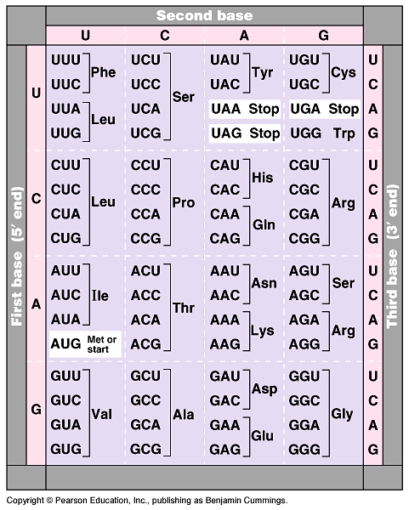
The code
For ALL life!
  strongest support for a common origin for all life
Code is redundant
  several codons for each amino acid
Why is this a good thing?
Start codon
  AUG
  methionine
Stop codons
  UGA, UAA, UAG
Notes:
Strong evidence for a single origin in evolutionary theory.

Slide 44
cytoplasm
transcription
translation
protein
nucleus
44

Slide 45
Let’s Practice
DNA- A-T-G-T-A-A-G-C-T-A-T-A-G-C-C
mRNA- U-A-C-A-U-U-C-G-A-U-A-U-C-G-G
tRNA- A-U-G-U-A-A-G-C-U-A-U-A-G-C-C
Amino acids
Tyr- Ile- Arg- Tyr- Arg

Slide 46
Check your understanding

Slide 47
Lesson 5: Mutations
Objective: Contrast gene mutations and chromosomal mutations

Slide 48
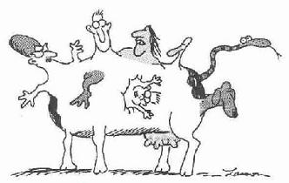

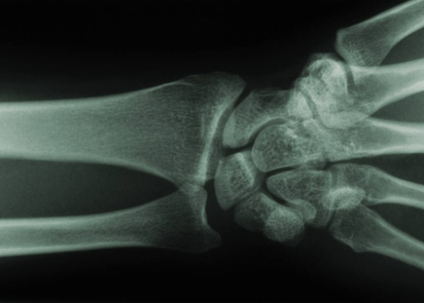
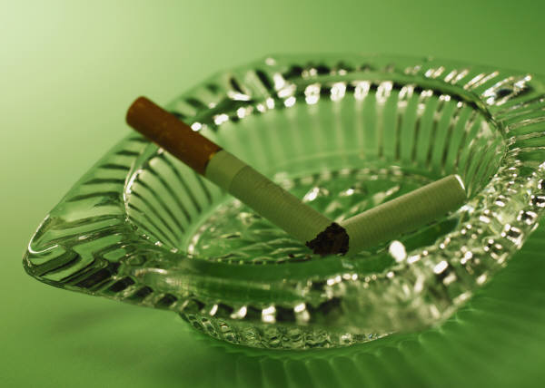
Mutations
A change/error in the linear sequence of a DNA molecule
A random alteration of DNA
Source of variation
Mutagens (agents that can cause damage to DNA): UV light, X-rays, pollutants, tobacco smoke, asbestos

Slide 49
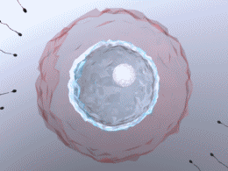
Mutations
If mutation occurs in the sex
cells, it may be passed on to offspring.
If mutation occurs in the body cells, it may only be passed on to other body cells; only affects the individual.

Slide 50
Chromosomal Mutations continued
If normal sequence is ABCDEFG
  Translocation adds a piece from another chromosome ABCDEFGXYZ
  Inversion changes the order ABEDCFG
  Addition adds/repeats a piece from the original chromosome ABCABCDEFG
  Deletion removes a piece ABCFG

Slide 51
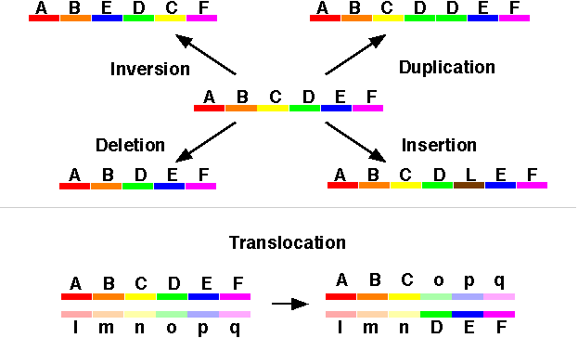
Types of Mutations
(Different colors represent different genes)

Slide 52
Chromosomal Mutations continued
  Non-disjunction: the addition or loss of whole chromosomes
    Occurs when the chromatids do not separate during anaphase
  Polyploidy: containing a multiple of the normal chromosomal # (3n, 4n etc.)
    Typically occurs with plants and results in larger than normal fruits

Slide 53
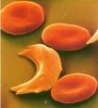
How do DNA mutations affect proteins?
Change in the nucleotide sequence of DNA may lead to a change in the amino acid sequence of a protein
The shape of the protein may be affected (incorrect folding)and the protein doesn’t do its job (malfunctions).
Example: Sickle Cell Anemia

Slide 54
Check your understanding

Slide 55
Lesson 6: Gene expression
Objective: Explain the relationship between genes and proteins

Slide 56
Gene Expression
Each cell uses only some of the genetic information it contains.
Proteins are synthesized only from genes that are expressed or “turned on;” all other genes are not expressed or “turned off.”
Ex: genes that code for liver enzymes are not expressed in nerve cells
Proteins determine your physical traits (phenotype)

Slide 57
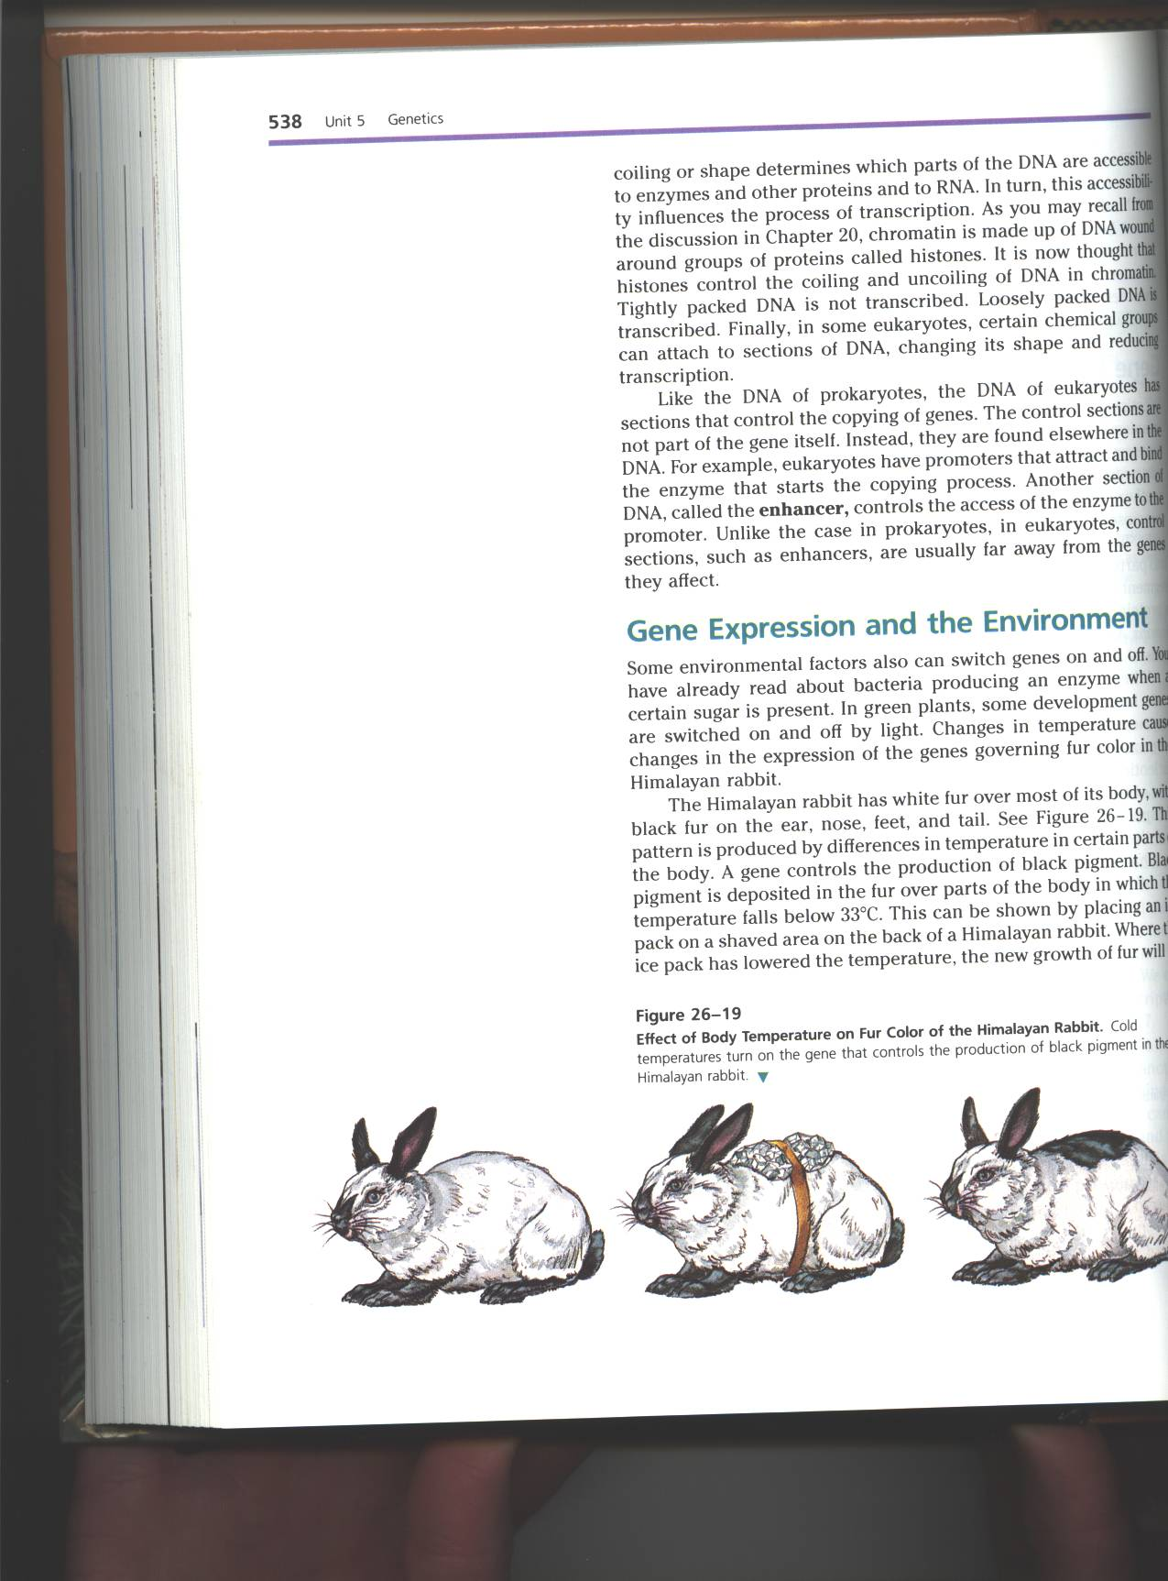
Gene Expression
Influenced by the environment
Example: Himalayan Rabbit
- cold temperature turns on gene for black pigment
Example: identical twins raised separately
- twin living in city may develop cancer
while twin living in the country may not

Slide 58
During the warm temperatures of summer, the arctic fox produces enzymes that cause its fur to become reddish brown. During the cold temperatures of winter, these enzymes do not function. As a result, the fox has a white coat that blends into the snowy background. This change in fur color shows that
the genes of a fox are made of unstable DNA
mutations can be caused by temperature extremes
random alteration of DNA can occur on certain chromosomes
the expression of certain genes is affected by temperature

Slide 59
Gene expression

Slide 60
Check your understanding

Slide 61
Lesson 7 Genetic technology
Objective: To relate biotechnology to the production of products or organisms with useful traits.

Slide 62
Genetic Engineering
Transferring DNA from one organism to another
Ex: transferring the human insulin gene into a plasmid (circular ring of bacterial DNA) and then inserting this plasmid into a host cell (bacterial cell)
As bacterial cell divides, so does human insulin gene. Human insulin can be used to treat people with diabetes.
Reduction in cost and side effects.

Slide 63
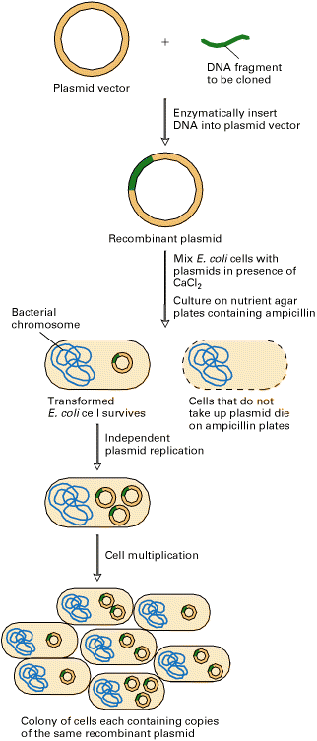
Using Bacteria Plasmids
(Think of insulin production!)

Slide 64
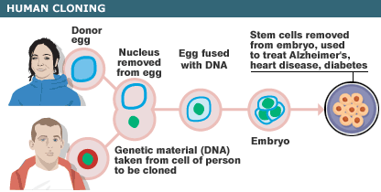
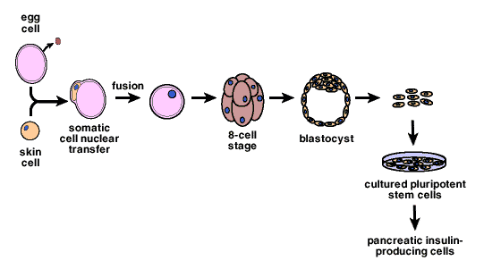

Slide 65
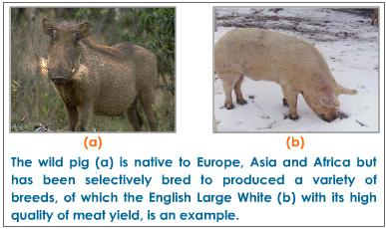
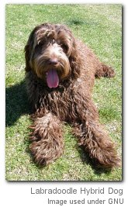
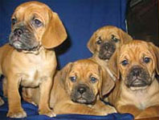
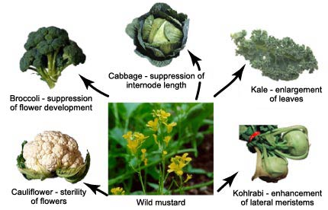
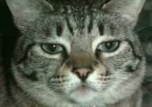
Selective breeding-Pets and food!!!!
Hybrid Name | Hybrid of these two Dog Breeds
Labradoodle | Labrador Retriever | Poodle
Goldendoodle | Golden Retriever | Poodle
Catahoula Bulldog | Catahoula Leopard Dog | American Bulldog
Cavapoo | Cavalier King Charles Spaniel | Poodle
Cockapoo | American Cocker Spaniel | Poodle
Deagle | Dachshund | Beagle
Cockernese | Cocker Spaniel | Havanese
Dorgi | Dachshund | Welsh Corgi
Schnug | Pug | Schnauzer
Schnoodle | Schnauzer | Poodle
Maltepoo | Maltese | Poodle
Pom-a-poo | Pomeranian | Poodle
Bug | Boston Terrier | Pug
Poogle | Poodle | Beagle
Puggle | Pug | Beagle
Yorkie Pin | Yorkshire Terrier | Miniature Pinscher
Shih-poo | Shih Tzu | Poodle
Ham anyone?
Puggles
Hypo-allergenic cats

Slide 66
PCR=Polymerase Chain Reaction
Large quantities of DNA can be copied in vitro from a small sample
Used for forensics, research and genetic counseling

Slide 67
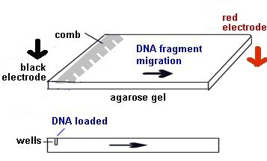
Restriction Enzymes and Gel Electrophoresis
Allows scientists to isolate DNA as well as to sequence DNA strands
Restriction enzyme-cuts DNA between specific base pairs
Used for forensics, research, genetic counseling
Gel Electrophoresis animation

Slide 68
Check your understanding

