Slide 1
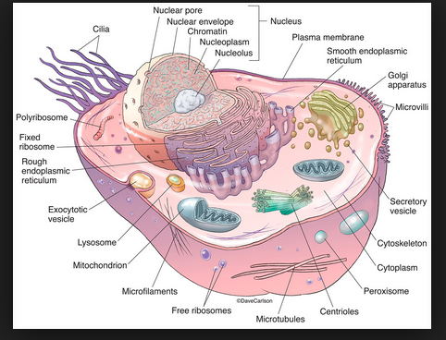
Unit 3 Cells part 2
Ms. Randall

Slide 2
Lesson 3: Cellular Communication
Objective:
To describe the role of receptors in cellular communication.

Slide 3
Cell Communication
To survive, cells must
Communicate with their neighbors
Monitor environmental conditions
Respond appropriately

Slide 4
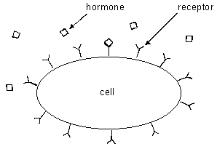
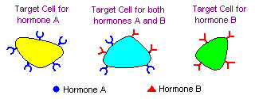
Recognizing signals (cell membrane)
Cells communicate by sending chemical messages (hormones)
Cell membranes have receptor molecules that
recognize these messages

Slide 5
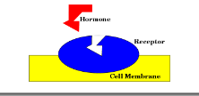
Receptor molecules ­ proteins in cell membrane
Hormones- proteins made (synthesized) by
other cells

Slide 6
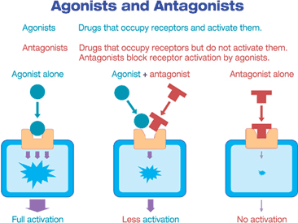
Cell receptors can be blocked by a molecule or drug that permanently or temporarily binds the receptor. This is how many pain medicines and cancer medicines work.

Slide 7
Let’s watch…
Cell signals

Slide 8
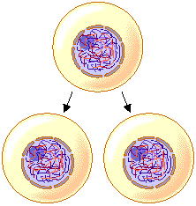
Lesson 4: Cell Reproduction
Objective:
To define the process in which cells create new cells.

Slide 9
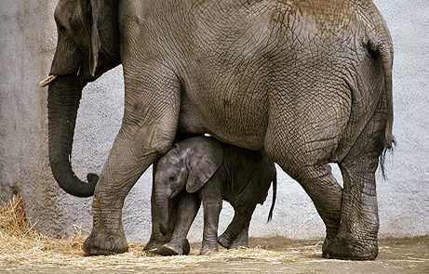
How do little elephants grow up to be BIG elephants?

Slide 10
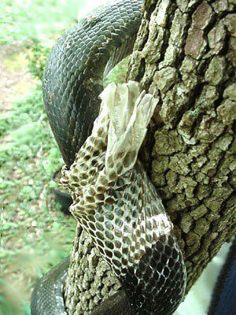
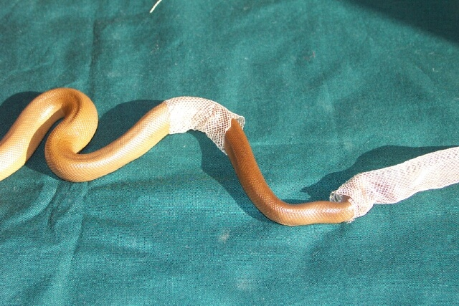
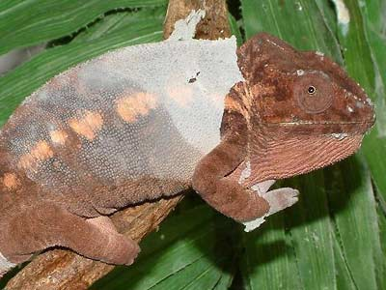
Why do animals shed their skin?

Slide 11
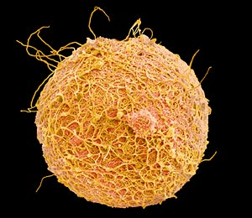
The process of asexual reproduction (cell division) begins after a sperm fertilizes an egg.

Slide 12
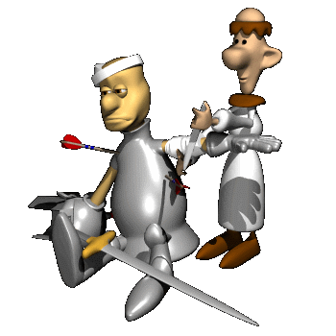
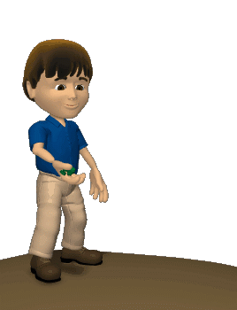
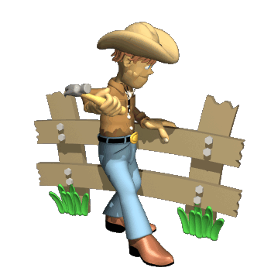
Three reasons why cells reproduce by asexual reproduction: 1. Growth 2. Repair 3. Replacement

Slide 13
Mitosis
Division of somatic cells (body)
Somatic Cell
Daughter Cells

Slide 14
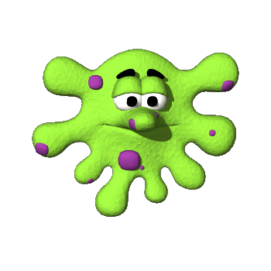
Mitosis = cell division
Interphase
Prophase
Metaphase
Anaphase
Telophase & Cytokinesis

Slide 15
Chromosome
DNA molecule with attached proteins
Sister chromatids
One from Mom
One from Dad
Look at figure 8.2

Slide 16
Interphase occurs before mitosis begins
Chromosomes are copied (# doubles)
Chromosomes appear as threadlike coils (chromatin) at the start, but each chromosome and its copy(sister chromosome) change to sister chromatids at end of this phase
CELL MEMBRANE
Nucleus
Cytoplasm

Slide 17
Interphase
Animal Cell
Plant Cell
Photographs from: http://www.bioweb.uncc.edu/biol1110/Stages.htm

Slide 18
Prophase 1st step in Mitosis
Mitosis begins (cell begins to divide)
Centrioles (or poles) appear and begin to move to opposite end of the cell.
Spindle fibers form between the poles.
Sister chromatids
Centrioles
Spindle fibers

Slide 19
Prophase
Animal Cell
Plant Cell
Spindle fibers
Centrioles
Photographs from: http://www.bioweb.uncc.edu/biol1110/Stages.htm

Slide 20
Metaphase 2nd step in Mitosis
Chromatids (or pairs of chromosomes) attach to the spindle fibers.
Centrioles
Spindle fibers

Slide 21
Metaphase
Animal Cell
Plant Cell
Photographs from: http://www.bioweb.uncc.edu/biol1110/Stages.htm

Slide 22
Anaphase 3rd step in Mitosis
Chromatids (or pairs of chromosomes) separate and begin to move to opposite ends of the cell.
Centrioles
Spindle fibers

Slide 23
Anaphase
Animal Cell
Plant Cell
Photographs from: http://www.bioweb.uncc.edu/biol1110/Stages.htm

Slide 24
Telophase 4th step in Mitosis
Two new nuclei form.
Chromosomes appear as chromatin (threads rather than rods).
Mitosis ends.
Nuclei
Nuclei
Chromatin

Slide 25
Telophase
Animal Cell
Plant Cell
Photographs from: http://www.bioweb.uncc.edu/biol1110/Stages.htm

Slide 26
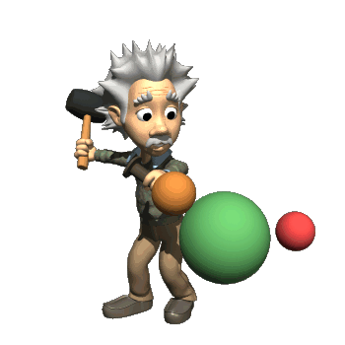
Cytokinesis occurs after mitosis
Cell membrane moves inward to create two daughter cells – each with its own nucleus with identical chromosomes.

Slide 27
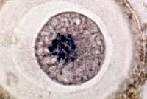
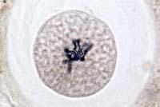
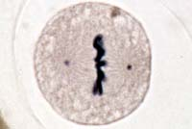
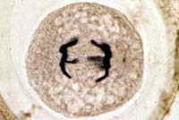
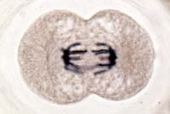
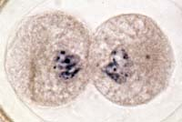
Animal Mitosis -- Review
Interphase | Prophase
Metaphase | Anaphase
Telophase | Interphase

Slide 28
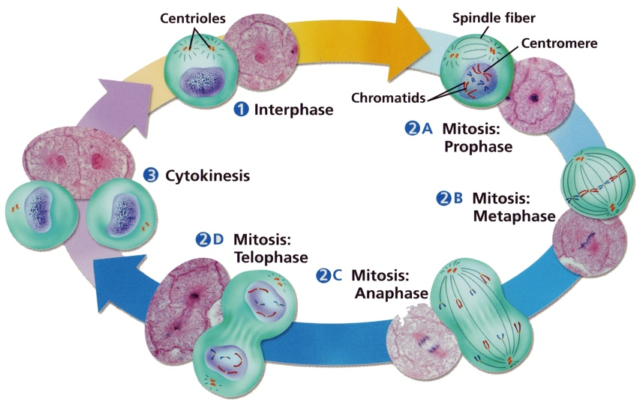
Cell Cycle
28

Slide 29
Mitosis Animation
Animation: Mitosis and Cytokinesis

Slide 30
Cancer
Occasionally, cells lose control of the cell cycle
This results from:
failure to produce certain enzymes,
the overproduction of enzymes
Or the production of enzymes at the wrong time.
Greatest Discoveries: Cancer Theories and Discoveries : Video : Science Channel

Slide 31
Cancer
Tumors are abnormal growth of cells
Benign tumors are non cancerous and only grow locally
Malignant tumors are cancerous and spread to other areas of the body

Slide 32
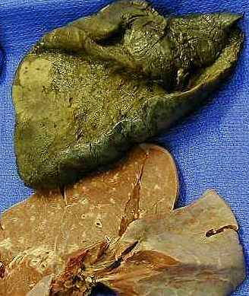
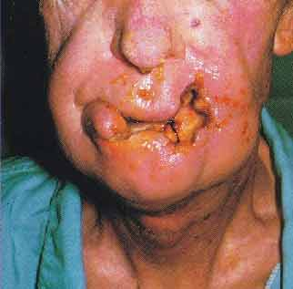
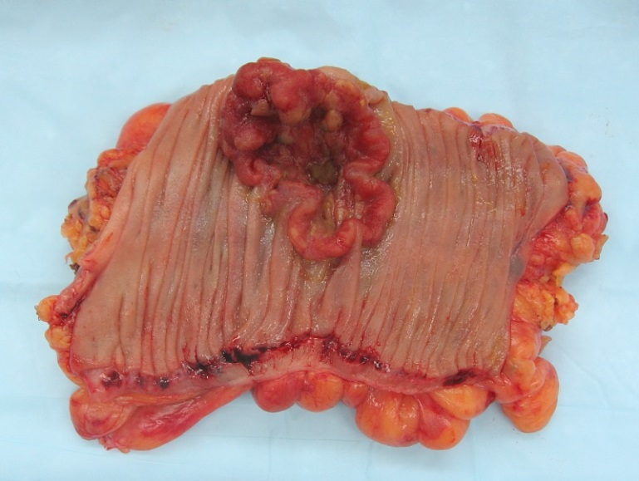
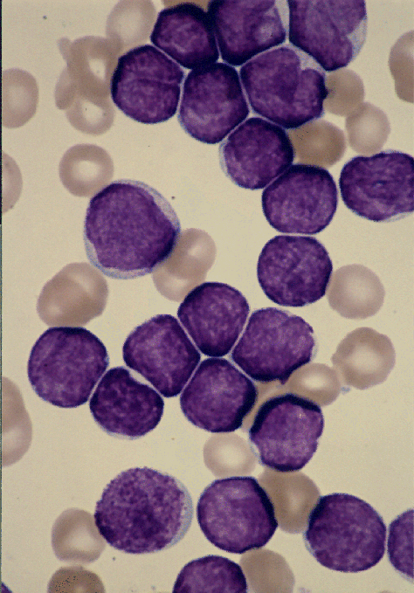
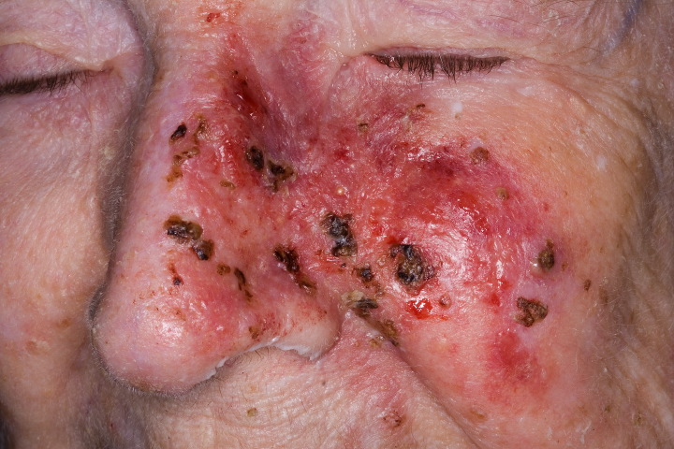

Slide 33
Cancer
Cancer is the second leading cause of death in the U.S.
Lung, colon, breast, and prostate cancers are the most prevalent types
Cancer stats Newsday

