Slide 1
Unit 3 Atomic Theory
Ms. Randall

Slide 2
Lesson 1: Concept of an Atom
Objective:
Describe how the modern model of the atom has evolved over a long period of time through the work of many scientists
Relate experimental evidence to models of the atom
Describe in detail Rutherford’s Experiment and the conclusions he made

Slide 3
The Evolution of the Atomic Model
Atom = basic building block of matter; cannot be broken down chemically
Democritus = (450 BC) used the term “atomos” to describe the ultimate/smallest particle of matter

Slide 4
Dalton (1803)
Known as the FOUNDER of the atomic theory
Dalton invented the word ATOM as the basic unit of matter which were considered to be INDIVISIBLE
Dalton also claimed that all atoms of a given element are IDENTICAL

Slide 5
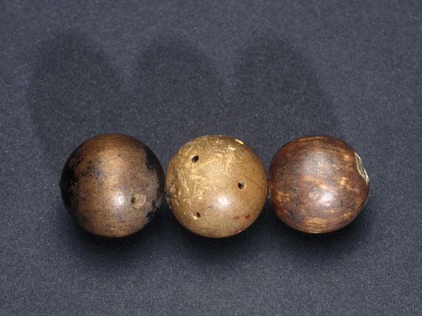
He also discovered that atoms of different elements have different PROPERTIES AND MASSES
Found that combining atoms of different elements formed COMPOUNDS
Theory referred to as the CANNONBALL theory (it looked like a
simple sphere)

Slide 6
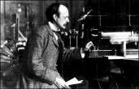
J.J. Thomson (1897)
While using a CATHODE RAY TUBE he discovered that the ray was deflected (due to a magnetic/electrical field)
From this discovery he concluded that atoms contain small negatively charges particles called ELECTRONS

Slide 7
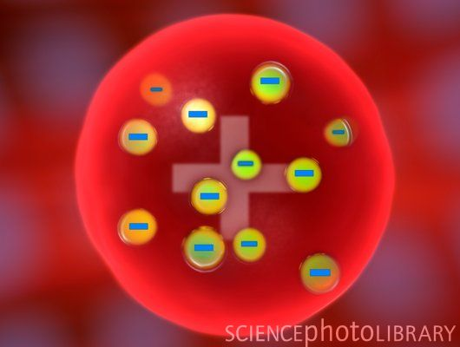
Theory famously referred to as the PLUM PUDDING model because he visualized the ELECTRONS being EMBEDDED within the structure of the atom (just like raisin bread)
The MASS of the rest of the atom (besides the electrons) was thought to be EVENLY DISTRIBUTED and POSITIVELY CHARGED

Slide 8
* Rutherford (1909) *
Experiment called the GOLD FOIL EXPERIMENT where he BOMBARDED a thin piece of GOLD FOIL with a POSITIVE STREAM OF ALPHA PARTICLES
Often referred to as the NUCLEAR model
Rutherford-Experiment

Slide 9
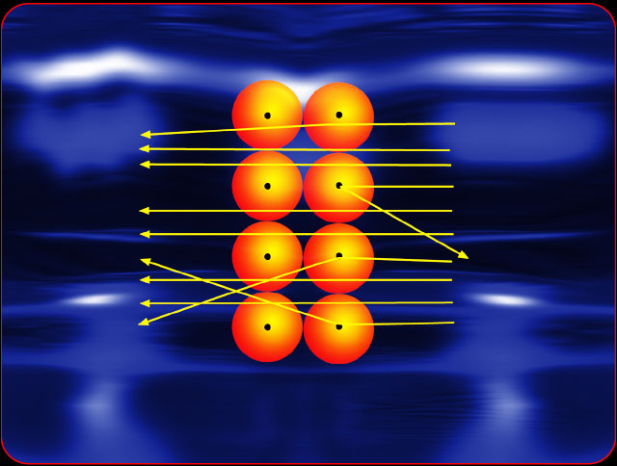
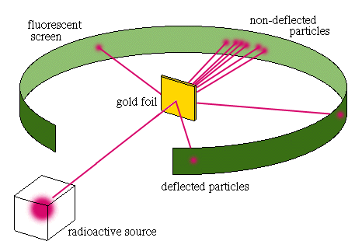
Most alpha particles WENT STRAIGHT THROUGH & some were DEFLECTED
Two conclusions were therefore made:
most of the atom is EMPTY SPACE
atoms have a small DENSE, POSITIVE, CENTRAL CORE called the NUCLEUS

Slide 10
* Neils Bohr (1913) *
Proposed that the atom consists of a dense nucleus with ELECTRONS found in WELL-DEFINED ORBITS/PATHS
He therefore stated that each electron orbiting the nucleus must possess a DEFINITE AMOUNT OF ENERGY to keep it in place within its orbital

Slide 11
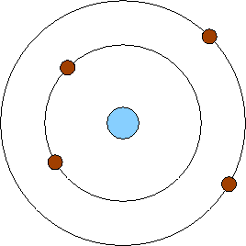
Known as the PLANETARY model (looks much like our solar system)

Slide 12
Wave-Mechanical/Cloud Model (Modern, present-day model)
Developed after the famous discovery that energy is made up of BOTH WAVES & PARTICLES
Still the same dense positively charged NUCLEUS

Slide 13
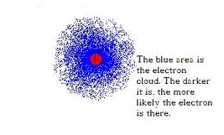
Electrons now have distinct amounts of energy and move in areas called ORBITALS or REGIONS AROUND THE NUCLEUS WHERE ELECTRONS ARE MOST LIKELY TO BE FOUND (PROBABILITY)
Different from the Bohr diagram—now the location of the electron is based on PROBABILITY within the orbital

Slide 14
A Song to Remember!!!!
Atomic Theory Song

Slide 15
Check your understanding and practice

Slide 16
Lesson 2: Subatomic Particles
Objective:
Identify the subatomic particles of an atom (proton, neutron, and electron)
Determine the number of protons, neutrons, electrons, nucleons and nuclear charge in a neutral atom

Slide 17
Atoms
Bill Nye Atoms

Slide 18
Table O

Slide 19
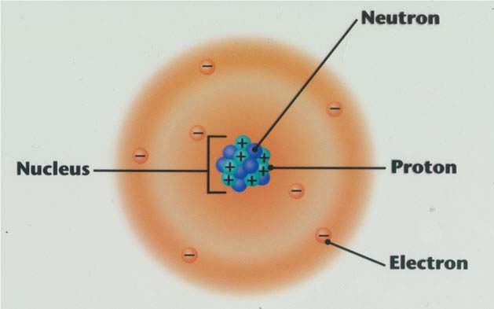

Slide 20
The subatomic particles found in the nucleus each have an approximate relative mass of 1 amu or atomic mass unit

Slide 21
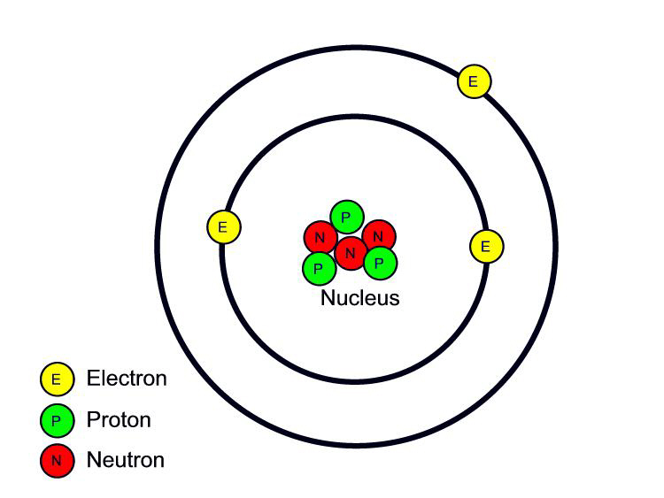
The word “atom” implies that the number of protons (positives) equals the number of electrons (negatives) to create a “neutral” atom.

Slide 22
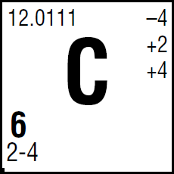
VOCABULARY (of the Periodic Table)

Slide 23
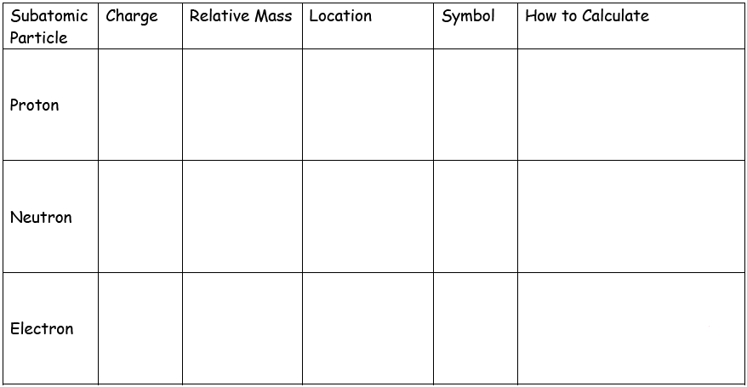
Subatomic Particles
1
p
1
1
n
0
0
e
-1

Slide 24
Mass Number=
Sum of the protons and neutrons in an atom of an element (p+n) = mass #
Nuclear Charge=
charge w/in the nucleus; equal to the # of protons or the atomic # (p= nuclear charge)
Nucleons=
any subatomic particles found w/in the nucleus (protons + neutrons)

Slide 25
Check your understanding and practice

Slide 26
Lesson 3:Subatomic Particles & Ions
Objective:
Determine the number of protons, neutrons, and electrons in an ion

Slide 27
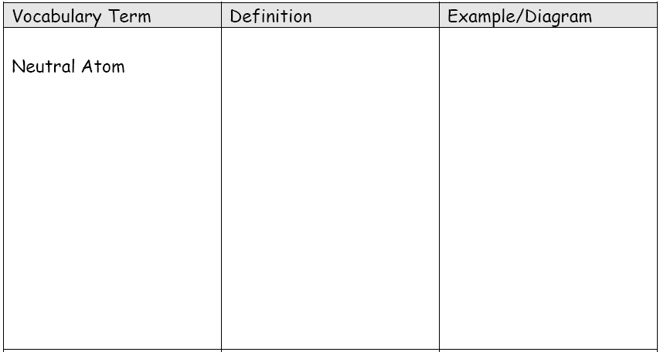
C-12
No charge indicated
All elements on periodic table
protons = electrons

Slide 28
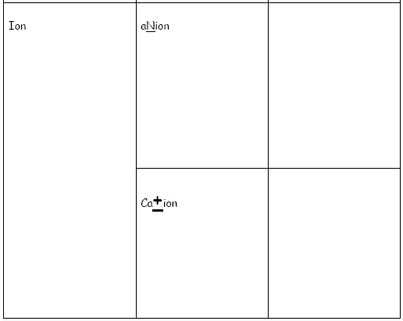
The -1 indicates one negative charge (1 extra electron)
Electrons > protons
The +1 indicates one positive charge (1 less electron)
protons > electrons

Slide 29
Check your understanding and practice

Slide 30
Lesson 4: Subatomic Particles & Isotopes
Objective:
Differentiate between atomic number, mass number, and (average) atomic mass
Calculate the (average) atomic mass for all isotopes of an element
Calculate the number of neutrons in an isotope

Slide 31
Isotope
atoms of the same element with different mass #’s;
same atomic #, different mass #’s; same number of protons, different number of neutrons

Slide 32
Example: Isotopes of Carbon (C-12, C-13, & C-14)
Different mass numbers
O r C-12
O r C-13
O r C-14

Slide 33
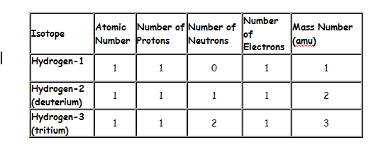
Look at Hydrogen…

Slide 34
Atomic Mass = the weighted average of an element’s naturally occurring isotopes
(%abundance x mass of isotope 1) + (%abundance x mass of isotope 2)
100

Slide 35
Example 1
Step 1: Multiply the mass of each isotope by its percent abundance.
Step 2: Add them up.
Step 3: Divide by 100.
(98.89% x 12amu ) + (1.11% x 13amu )=
100
=
12.011amu

Slide 36
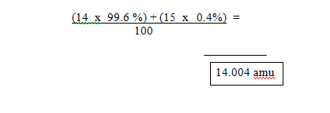
Example 2:
Nitrogen has two naturally occurring isotopes. ¹⁴N occurs 99.6% of the time and ¹⁵N occurs 0.4% of the time. Calculate the average atomic mass of nitrogen.

Slide 37
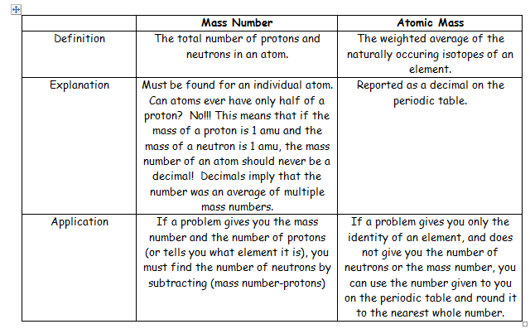

Slide 38
Check your understanding and practice

Slide 39
Lesson 5: Bohr Diagrams
Objective:
Construct Bohr diagrams for atoms and ions
.

Slide 40
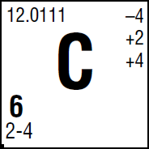
ELECTRON CONFIGURATIONS
A dashed chain of numbers found in the LOWER LEFT CORNER of an element box (see below); tells us the number of ENERGY LEVELS as well as the number of ELECTRONS in each level (tells us how the electrons are arranged around the nucleus)

Slide 42
Valence Electrons:
electrons found in the OUTERMOST shell or orbital; the LAST number in the electron configuration
They determine REACTIVITY!!!
Inner electrons are called Kernel elctrons

Slide 43
Examples:
Sulfur # of valence electrons:
# of Kernel electrons:
Nitrogen # of valence electrons:
# of Kernel electrons:
6
10
5
2

Slide 44
Principle Energy Level (n) =
energy levels that contain a certain number of ELECTRONS.
Maximum # of electrons in an energy level = 2n² where n = PERIOD #.
Principle Energy Level (n) | Maximum number of electrons ( )
1
2
3
4
Sample question: How many Principle energy levels do the electrons occupy in the following configuration 2-8-1?
3

Slide 45
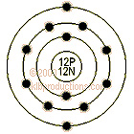
BOHR DIAGRAMS
(one method for expressing electron location in an atom or ion); ALL ELECTRONS MUST be drawn

Slide 46
Bohr Diagrams are drawings that show the structure of the atom.
Step 1: Draw a nucleus and label it with the correct number of protons and neutrons.
Step 2: Look up the electron configuration for the element. (Use key on Periodic table.) The e- configuration tells us how many electrons are on each orbital.
.

Slide 47
Step 3: Draw the correct number of orbitals around the nucleus and label them with the correct number of electrons
Example: Nitrogen

Slide 48
Check your understanding and practice

Slide 49
Lesson 6: Electrons and Energy
Objective:
Differentiate between excited and ground state
Explain how light is produced
Identify substances based upon their bright line spectra

Slide 50
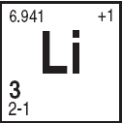
Ground State =
electrons in LOWEST ENERGY CONFIGURATION possible (configuration found on PERIODIC TABLE)

Slide 51
Excited State =
electrons are FOUND IN A HIGHER ENERGY CONFIGURATION (ANY configuration NOT found on Periodic Table)

Slide 52
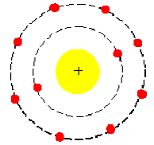
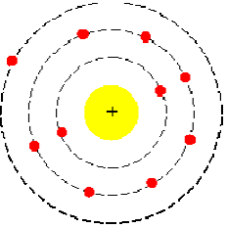
Ground State vs. Excited State

Slide 53
So how can you tell if you have a ground state or excited state configuration?

Slide 54
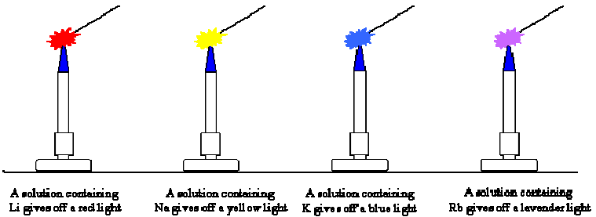
The greater the distance from the nucleus, the greater the energy of the electron

Slide 55
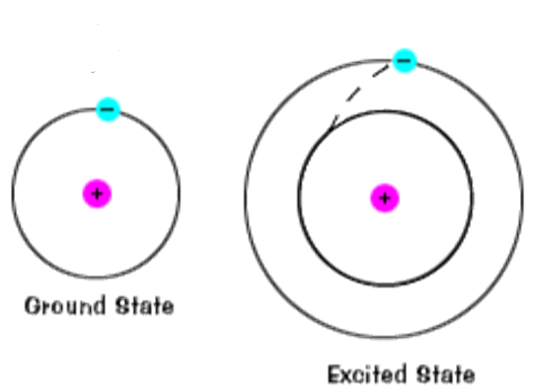
When atoms ABSORB ENERGY their ELECTRONS will shift to a HIGHER energy level or AN EXCITED STATE.
Electrons ABSORB ENERGY

Slide 56
This is a very UNSTABLE/TEMPORARY condition so the electrons will FALL BACK DOWN or DROP TO A LOWER state energy level (or THE GROUND STATE.)
When they FALL BACK DOWN from the excited state to the ground state they release energy in the form of LIGHT.

Slide 57
Electromagnetic Spectrum
More Energy released
Less Energy released

Slide 58
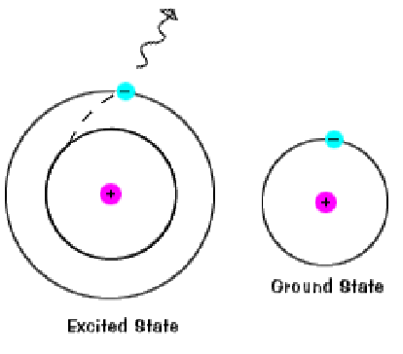
Electrons RELEASE ENERGY as LIGHT
Light

Slide 59
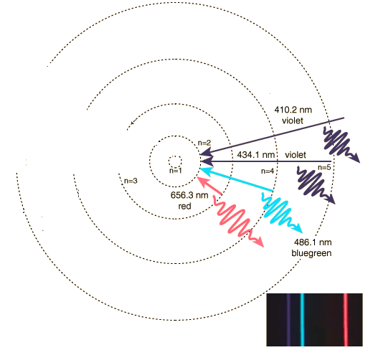
Different elements produce different colors of light or SPECTRA. These spectra are UNIQUE for each element (just like a human fingerprint is unique to each person).
We therefore use spectra lines to DETERMINE which element we have because each element gives off a characteristic Bright line spectra.

Slide 60
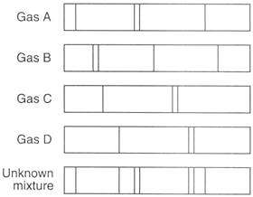
What Gases Comprise the Unknown?

Slide 61
Unknown Mixture is made up of Gas A and Gas D

Slide 62
Check your understanding and practice

Slide 63
Check your understanding and practice

Slide 64
Flame Test
Greatest Discoveries Shorts: Atoms Signature Light : Video : Science Channel
Flame Test Lab Activiy
Teachers' Domain: Fireworks! Making Color
http://www.wired.com/geekdad/2010/07/the-chemistry-of-fireworks/

Slide 65
Lesson 7: Lewis Dot Diagrams:
Objective:
Construct Lewis dot diagrams for atoms and ions

Slide 66
LEWIS (ELECTRON) DOT DIAGRAMS
a shorter way of expressing electron location
Only illustrates VALENCE ELECTRON CONFIGURATION!

Slide 67
Write the element’s symbol
Retrieve electron configuration from Periodic Table. The last number in the configuration is the NUMBER OF VALENCE ELECTRONS

Slide 68
Arrange the valence electrons (DOTS) around the symbol using the following rules:
Only two electrons maximum per side of the symbol (therefore no more than 8 total surrounding symbol – 8 is great!)
Always “pair” the first two
If you have more than 2 valence electrons, deal them one at a time to the other three sides until you run out

Slide 69
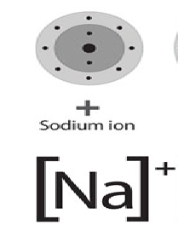
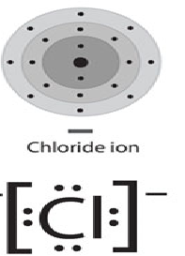
If you are working with an ion you must adjust the valence electrons (add or subtract electrons) in the configuration before constructing your Dot Diagram – be sure to draw your final diagram with the initial charge on the ion

Slide 70
Check your understanding and practice

Slide 71
Video on Demand - The World of Chemistry - The Atom
Run time 27 minutes

