Slide 1
Unit 12 Organic Chemistry
Ms. Randall

Slide 2
Lesson 1: What is an Organic Compound?
Objective:
Differentiate between an organic compound and an inorganic compound
Explain why organic properties make them insoluble in water and have relatively low BP
Differentiate between saturated and unsaturated hydrocarbons
Determine the name of alkanes, alkenes and alkynes using Table P and Q

Slide 3
Organic Chemistry
Study of carbon containing compounds
Organic Compound: Contains CARBON and HYDROGEN
Major sources of organic compounds are:
petroleum, coal, wood, plants, & animals

Slide 4
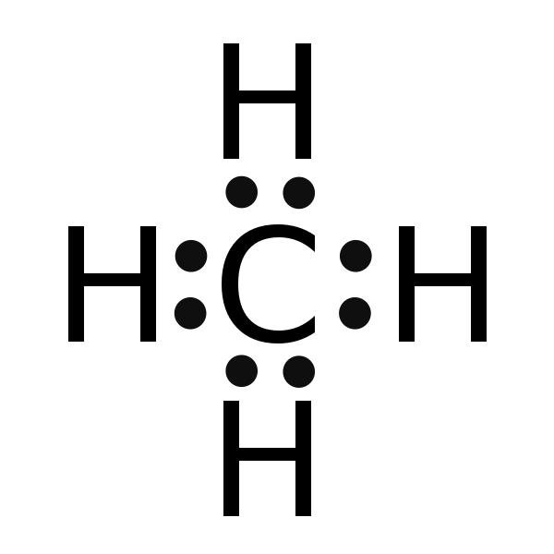
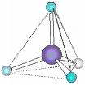
Properties of Carbon
Carbon forms 4 COVALENT BONDS which may be single, double or triple
Due to 4 unpaired electrons
Shape is tetrahedral
Χ
●
C
●
●
Χ
Χ
Χ
●

Slide 5
Types Of Bonds
Single Bond – single covalent bond in which they share 1 pair of electrons. (2 e-)
●
●
C
C
C
C
●
●
●
●
●
●

Slide 6
Double Bond – carbon atoms may share 2 pairs of electrons to form a double bond.
●
●
C
●
●
C
C
C
●
●
●
●

Slide 7
Triple Bond – carbon atoms may share 3 pairs of electrons to form a triple bond.
●
●
C
C
●
C
●
●
C
●
●
●

Slide 8
HYDROCARBONS
Organic compounds that ONLY contain CARBON and HYDROGEN

Slide 9
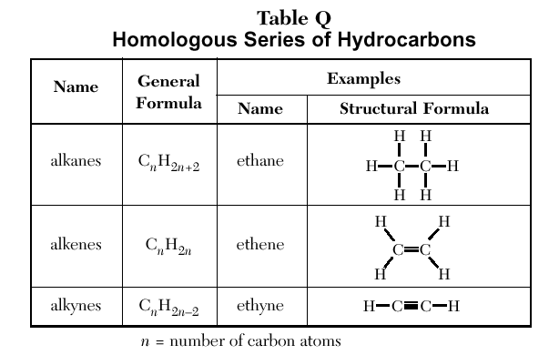
HOMOLOGOUS SERIES
Group of organic compounds with similar properties and structures
TABLE Q gives the general formula and examples (name and structure)

Slide 10
1. SATURATED HYDROCARBONS
Contains SINGLE bonds ONLY!!
number of hydrogen is maximized (saturated)
Example:

Slide 11
ALKANES
Group of SATURATED hydrocarbons with the general formula: C_{n}H_{2n+2}
Used as burning FUELS
Example: propane

Slide 12
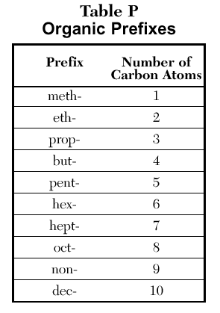
NAMING ALKANES
Count up the # of carbons
Use TABLE P to determine the prefix
Name ends in -ANE

Slide 13
Example: C₅H₁₂
1
2
3
4
5
5 carbons (5 = pent)
All single Bonds (ANE)
C₅H₂₍₅₎₊₂
Name: PENTANE

Slide 14
PRACTICE: Name the following Alkanes
CH₄
C₂H₆
Methane
Ethane

Slide 15
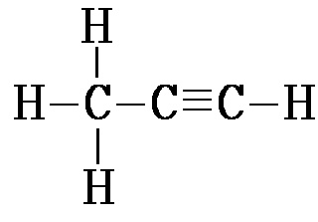
2. UNSATURATED HYDROCARBONS
At least 1 double or triple bond between carbons
(not saturated with hydrogens)

Slide 16
ALKENES
Group of UNSATURATED hydrocarbons with the general formula: C_{n}H_{2n}
Contains 1 Double Bond
Always twice as many hydrogens as carbons in formula

Slide 17
NAMING ALKENES
Same as naming alkanes except:
Name ends in ENE

Slide 18
EXAMPLE: C₅H₁₀
5 carbons (5 = pent)
Contains Double Bond (ENE)
C₅H₂₍₅₎
Name: PENTENE

Slide 19
PRACTICE: Name the following ALKENES
C₂H₄
C₄H₈
Ethene
Butene

Slide 20
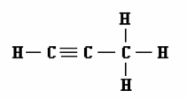
ALKYNES
Group of UNSATURATED hydrocarbons with the general formula: C_{n}H_{2n-2}
Contains 1 TRIPLE BOND

Slide 21
NAMING ALKYNES
Same as naming alkanes and alkenes except:
Name ends in YNE

Slide 22
Example: C₅H₈
5 carbons (5 = pent)
Contains TRIPLE Bond (YNE)
C₅H₂₍₅₎₋₂
Name: PENTYNE

Slide 23
Check your understanding and practice

Slide 24
Lesson 2: Structural formulas
Objective:
Differentiate between the structural formulas of alkanes, alkenes and alkynes
Construct structural formulas of alkanes, alkenes, and alkynes

Slide 25
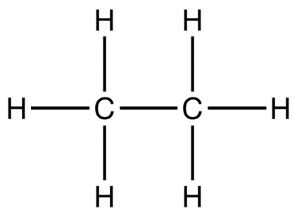
Types of Formulas
MOLECULAR FORMULA-shows the # OF ATOMS of each ELEMENT in a compound; least informative formula
STRUCTURAL FORMULA- diagram of the molecular structure of compound
CONDENSED STRUCTURAL FORMULA- each carbon is written separately followed by atoms bonded to it.
C₂H₆
CH₃CH₃

Slide 26
Drawing Structural Formulas of Alkanes
Use TABLE P and TABLE Q to determine # of CARBON and HYDROGEN
Remember each Carbon must have FOUR bonds

Slide 27
Example: Structural Formula for Methane
H
CH₄
H
C
H
H

Slide 28
Example: Structural and Condensed Structural Formula for Ethane
H
H
C₂H₆
H
C
C
H
H
H
CH₃CH₃

Slide 29
Drawing Structural Formulas of Alkenes
Same as Alkanes except….
If there are more than 3 carbons you need to give the location of DOUBLE BOND
Always START numbering the carbons at the end CLOSEST to the double bond

Slide 30
Example: ETHENE
H
H
C₂H₄
H
C
C
H
H
H
CH₂CH₂

Slide 31
Example: PROPENE
H
H
C₃H₆
H
C
C
C
H
H
H
CH₃CHCH₂

Slide 32
Example: BUTENE
C₄H₈
H
H
H
4
3
2
1
H
C
C
C
C
H
H
H
H
CH₃CH₂CHCH₂
1- Butene

Slide 33
Check your understanding and practice

Slide 34
Lesson 3: Branched alkanes
Objective:
Determine the name of branched alkanes

Slide 35
Naming Branched Alkanes
When naming branched alkanes, name the longest chain of CARBONS and use that as the ‘last name.’ Then name the shorter chains ALKYL GROUP, specifying the position of each branch. Also make sure that your branches are numbered as low as possible.

Slide 36
Locating the Parent Chain
These are all just butane!!!

Slide 37
NAMING ALKYL GROUPS (Branches)
Count # of carbons in alkyl group (branch)
Use prefix (TABLE P)
Add Suffix “yl” to prefix
Ex. –CH₃ (Methyl)

Slide 38
Example: Branched Alkane
7
6
5
4
3
2
1
CH3 - CH2 - CH2 – CH – CH₂ – CH - CH3
CH2
CH3
5
CH3
6
Step 1: Find the longest continuous chain of carbons (parent chain)
There are 7 continuous carbons, so the parent chain is
heptane

Slide 39
7
6
5
4
3
2
1
CH3 - CH2 - CH2 – CH – CH₂ – CH - CH3
4
5
6
7
1
2
3
CH2
CH3
CH3
Step 2: Number the carbons in parent chain starting with the end that will give the attached groups the smallest #.
The chain is numbered from right to left giving the attached groups the lowest #
heptane

Slide 40
7
6
5
4
3
2
1
CH3 - CH2 - CH2 – CH – CH₂ – CH - CH3
CH2
CH3
CH3
Step 3 : Add numbers to the names of the groups to identify their positions on the chain.
In this example the positions are:
2
- methyl - ethyl
4
heptane

Slide 41
7
6
5
4
3
2
1
CH3 - CH2 - CH2 – CH – CH₂ – CH - CH3
CH2
CH3
CH3
Step 4: List the alkyl groups in alphabetical order.
4-ethyl 2-methyl
heptane

Slide 42
7
6
5
4
3
2
1
CH3 - CH2 - CH2 – CH – CH₂ – CH - CH3
CH2
CH3
CH3
Step 5: Use punctuation
Commas separate numbers
Hyphens separate numbers and words.
4-ethyl-2- methyl heptane

Slide 43
**Use prefixes if the same group appears more than once in the structure.
CH3
CH3
CH3 - CH2 – CH – CH2 – CH - CH3
Di =
Tri =
= four times
= five times
twice
three times
Tetra
Penta

Slide 44
Example:
CH3
CH3
CH3 - CH2 – CH – CH2 – CH - CH3
6
5
4
3
2
1
1
2
3
4
5
6
Step 1: 6 carbons =
hex
So parent chain is
hexane
Step 2: number right to left

Slide 45
CH3
CH3
CH3 - CH2 – CH – CH2 – CH - CH3
6
5
4
3
2
1
Step 3: -methyl and -methyl
2
4
dimethyl
Step 5: 2,4- dimethylhexane

Slide 46
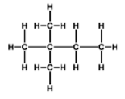
Example:

Slide 47
Check your understanding and practice

Slide 48
Lesson 4: Isomers
Objective:
Identify and construct isomers of alkanes, alkenes and alkynes

Slide 49
ISOMERS
Compounds with the SAME MOLECULAR formula but different STRUCTURAL FORMULA
Have different properties
The more carbons the more possible isomers

Slide 50
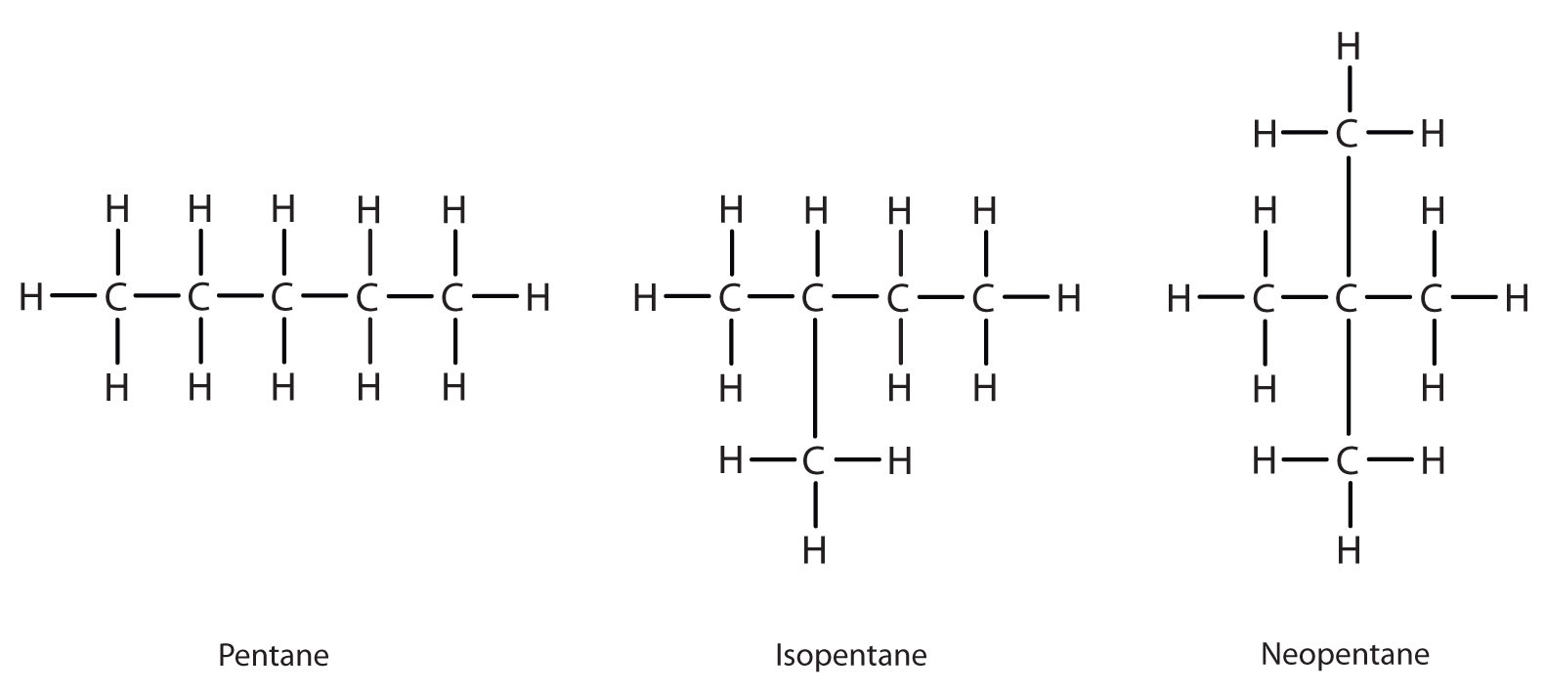
Match the isomers:

Slide 51
Drawing an isomer of an Alkane
Use same molecular formula
Draw a different structural formula
(if name of compound is different but it has the same molecular formula it is an isomer)
Branched alkanes

Slide 52
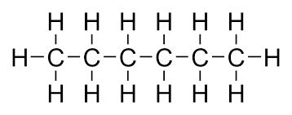
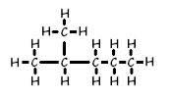
Example: Draw an isomer of hexane

Slide 53
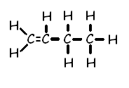
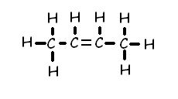
Isomers of Alkenes/Alkynes
Double or Triple bond in different locations
Example: Isomers of butene

Slide 54
Drawing an isomer of an alkene/alkyne
Use same molecular formula
Move the location of the double or triple bond
****Be careful not to move it into the same position. Remember you can read compounds left to right or right to left.

Slide 55
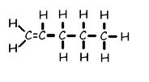
Example: Draw an isomer of 1-pentene

Slide 56
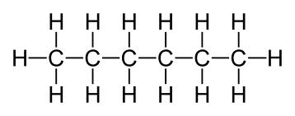
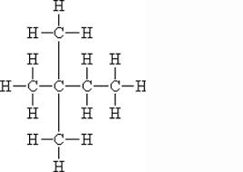
Which two compounds are isomers of each other?
2
1
3

Slide 57
Check your understanding and practice

Slide 58
Lesson 5: Functional groups
Objective:
Determine the name of the organic compound based upon the functional groups

Slide 59
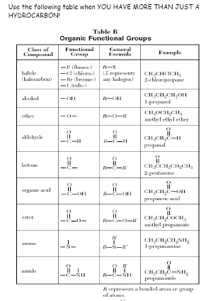

Slide 60
To Name or Draw substituted Hydrocarbons use Table R:
Use the example given in table R and compare to your problem.
Locate the class of compound and see how it is named or drawn in the example:
Use it as a model to draw or name your problem

Slide 61
Halides
Have one or more of the halogens as a branched group.
Name chain
Add halogen prefix
# location of halogen
1
2
3

Slide 62
Example
F
2- fluoropropane

Slide 63
Example:
If more than one of the same halogen use di, tri etc.
1, 2 dibromoethane

Slide 64
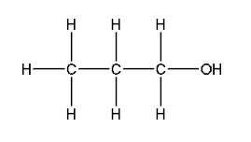
Alcohol
Functional group (OH)
Name chain
Suffix ol
# location of OH
3
2
1

Slide 65
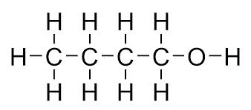
Example:
1-butanol

Slide 66
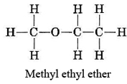
Ether
Name each chain then place in alpha order (*this is an exception)
suffix: -ether

Slide 67
Example:
methyl
methyl
H
H
H
C
O
C
H
H
H
Oxygen bridge
Dimethyl ether

Slide 68
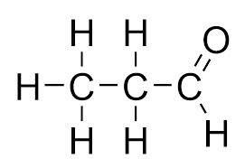
Aldehyde
Name chain
Suffix: al

Slide 69
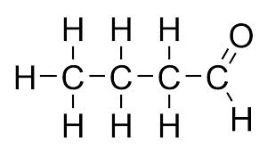
Example:
butanal

Slide 70
ketone
Name parent chain
Suffix: -one
# location of functional
group
1
2
3
4
5

Slide 71
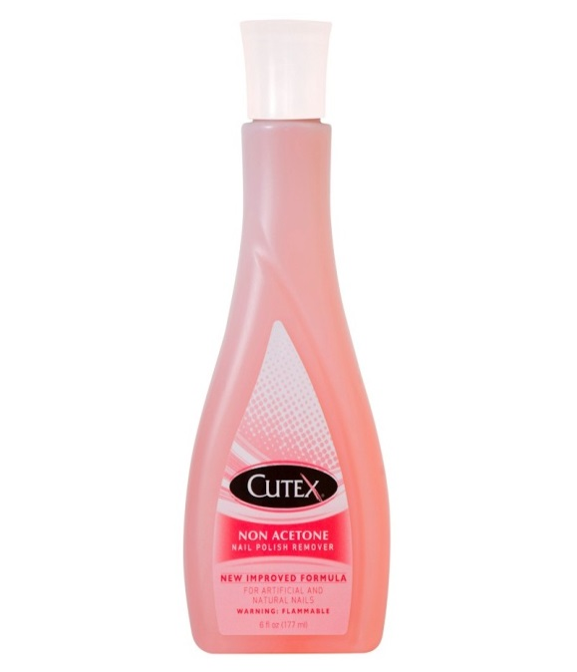
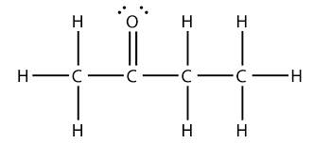
Example:
2- butanone
1
2
3
4
5

Slide 72
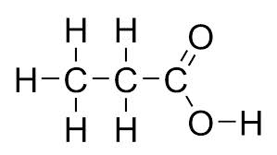
Organic Acids
Name parent chain
Drop ending and
add -oic acid
Carboxyl group

Slide 73
Example
H
O
H
C
C
OH
H
Ethanoic acid

Slide 74
Ester
Name chain bonded to O first
Name chain with double
bond =O last
Suffix: -oate

Slide 75
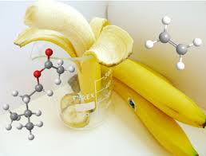
Example:
Ethyl propanoate

Slide 76
Amines
Name chain
Suffix: amine
H
H
H
H
C
C
C
NH₂
H
H
H

Slide 77
Example:
H
H
H
C
C
NH₂
H
H
ethanamine

Slide 78
Amides
Different than amines due to
double bonded =O
Name parent chain
Suffix: amide

Slide 79
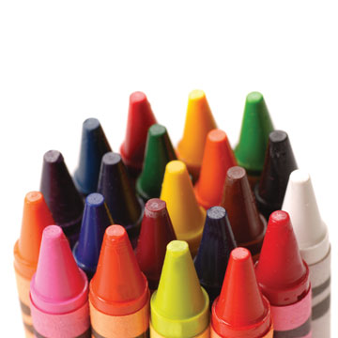
Example:
butanamide

Slide 80
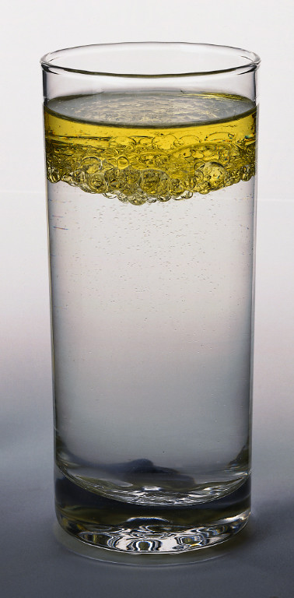
Properties of Organic Compounds
Generally NONPOLAR
INSOLUBLE in Water (like dissolves like)
SOLUBLE in Nonpolar substances
POOR Conductors of Electricity )non electrolytes) b/c they do not form ions

Slide 81
They have LOW melting points – due to WEAK INTERMOLECULAR forces.
C-C ● ● ● C-C
Combustible (flammable)
STRONG
weak
STRONG

Slide 82
Check your understanding and practice

Slide 83
Lesson 6: Organic Reactions
Objective:
Differentiate between the types of organic reactions
Compose addition and substitution reactions

Slide 84
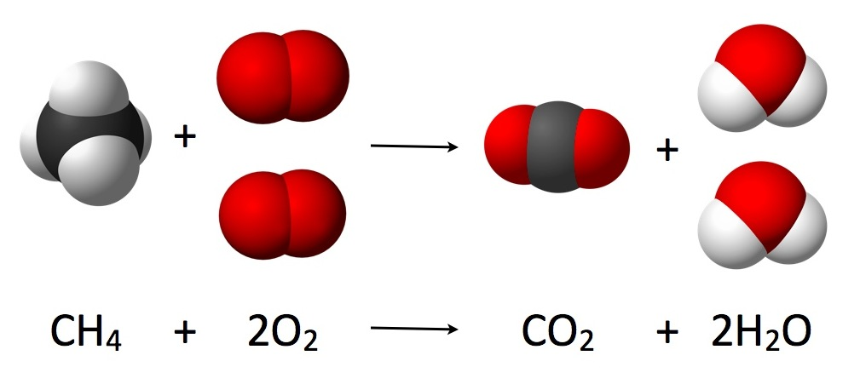
1. Combustion
Organic Compound is burned in the presence of oxygen to produce CO₂ and H₂O
O₂ is always a REACTANT!

Slide 85
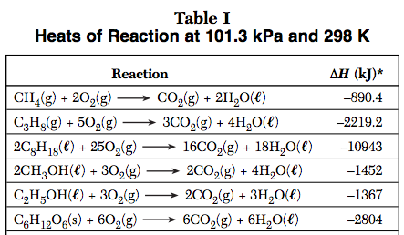

Slide 86
2. Substitution
Similar to single replacement: two atoms switch
First compound is saturated (single bonds)
One H is switched with one Halogen (group17).
CH₄ + Cl₂ → CH₃Cl + HCl

Slide 87
Example:

Slide 88
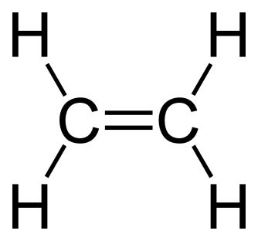
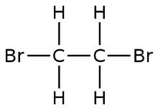
3. Addition
Double or Triple Bond is broken and two or more atoms are added
Molecule must be unsaturated
C₂H₄ + Br₂ → C₂H₄Br₂
+
Br₂
→

Slide 89
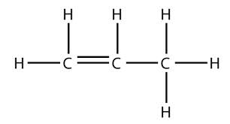
Example:

Slide 90
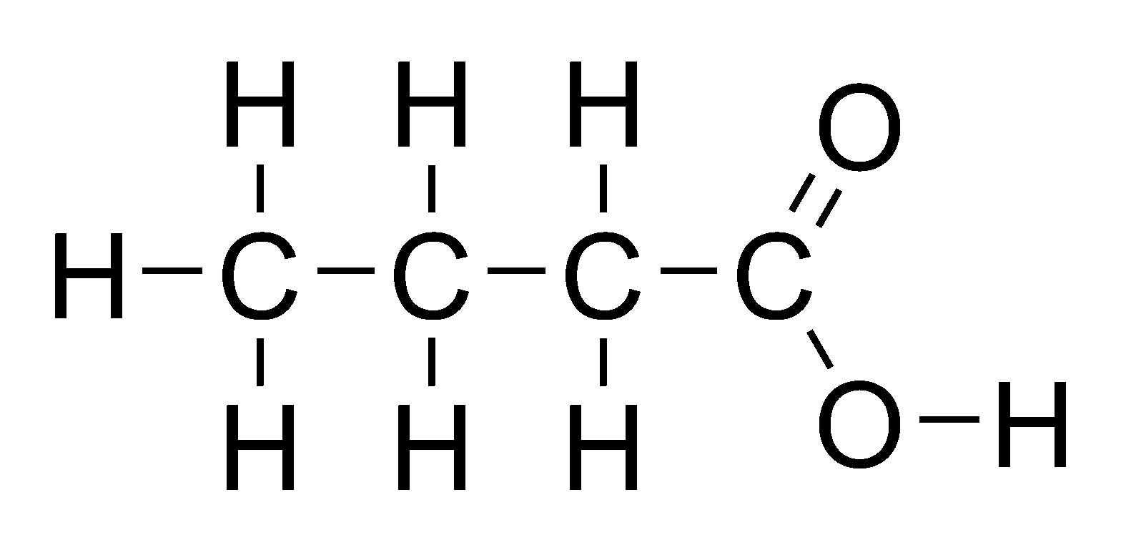
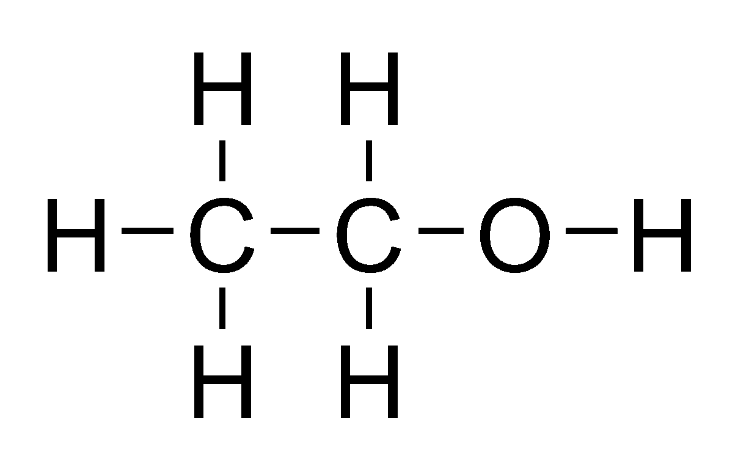
4. Esterification
Forms esters (smells)
Identify ester as product (Use TABLE R)

Slide 91
5. Fermentation
Enzymatic breakdown of sugar into alcohol (ethanol) and CO₂
Identify Alcohol and CO₂ as product
C₆H₁₂O₆→ 2C₂H₅OH + 2CO₂

Slide 92
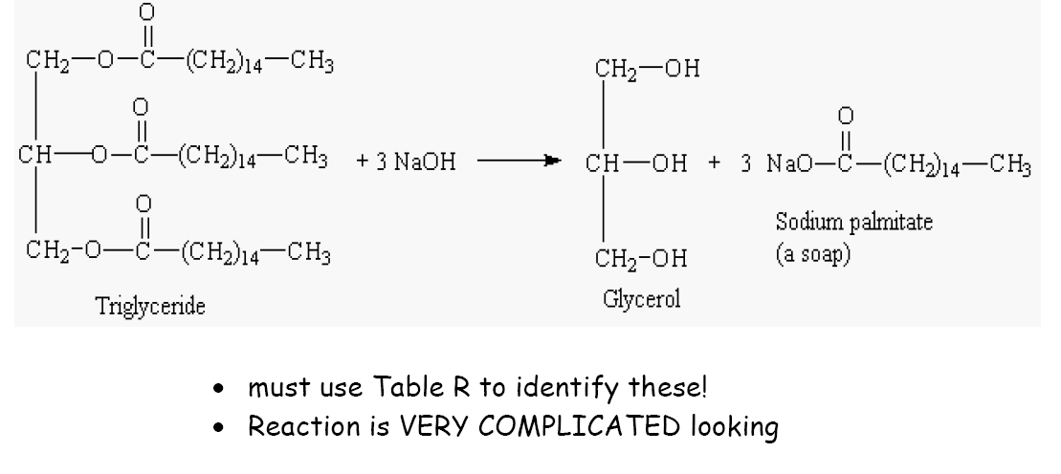
6. Saponification
Hydrolysis of fats using a base
Produces soap and glycerol (alcohol)
Identify soap as product and base as reactant

Slide 93
7. Polymerization
Formation of long-chain molecules (polymers) from small repeating subunits (monomers)
Can be natural (proteins) or artificial (plastics)
starch – long chains of sugars
proteins – long chains of amino acids
cellulose – made of repeating units of sugar

Slide 94
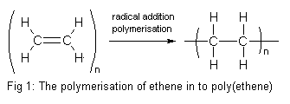
Addition Polymerization
Adding small alkenes together by breaking the double bond, to create a large chain.
Identify by “n” which represents a large number

Slide 95
Identify by repeating units (monomers) creating giant molecules
C
C
+
C
C
+
C
C
monomer
monomer
monomer
ethylene
ethylene
ethylene
C
C
C
C
C
C
polymer
polyethylene

Slide 96
Condensation Polymerization
Joining 2 molecules by removing water

Slide 97
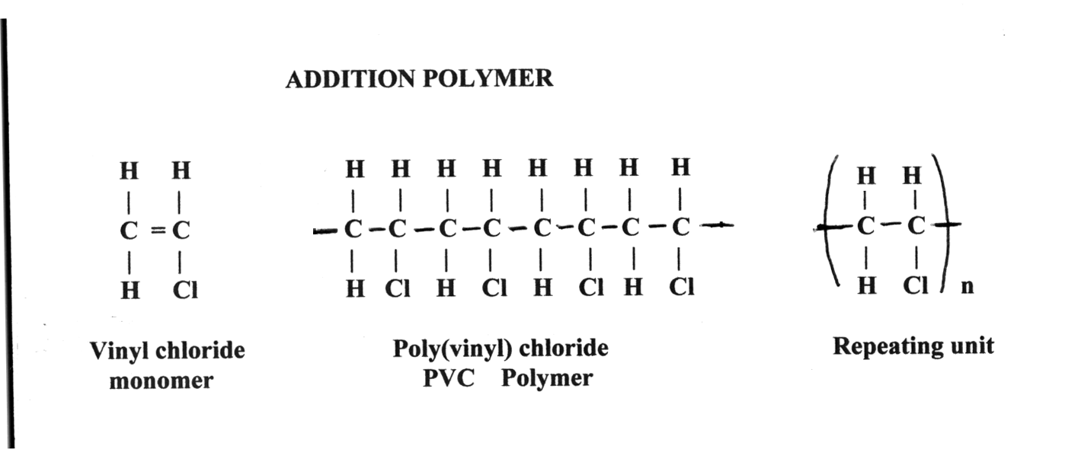
Addition vs. Condensation

Slide 98
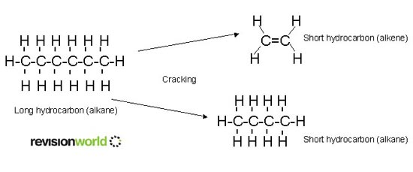
8. Cracking
Breaking large hydrocarbons into smaller chains by heating them.
Fossil fuels are cracked into many components such as octane (gasoline) propane, etc.

Slide 100
Finding missing reactants & products in organic rxns
In balanced rxns the number of atoms on the left must equal the number of atoms on the right.
Ex.)
C₂H₆
Cl₂
C₂H₅Cl
+
+
Left side | Right side | missing
C = | C = | C =
H = | H = | H =
Cl = | Cl = | Cl =
2
2
0
6
5
1
2
1
1
Missing product must be HCl
This is a substitution rxn because hydrogen atom of ethane is replaced by chlorine.

Slide 101
Check your understanding and practice

