Slide 1
Marine Science Questionnaire
Answers

Slide 2
True!
Killer Whales often play with their food before eating it.
Meal time

Slide 3
False!
A whale shark eats whales
They are filter feeders!

Slide 4
True!
A barnacle has a penis that extends to three times its body length.
Let’s watch!!!

Slide 5
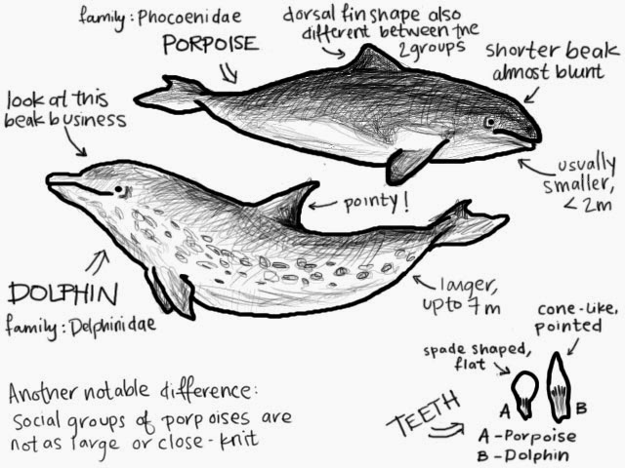
False!
Dolphins and porpoises are the same animal.

Slide 6
False!
A fire coral is named for its fire engine red color.
Fire corals are not true corals. Fire corals (Millepora alcicornis) are members of the Cnidaria phylum, and although fire coral looks like coral, it is a member of the class Hydrozoa and more closely related to jellyfish and other stinging anemones. Fire corals are typically encountered off the Florida coast, in the Caribbean reefs and across the Bermuda platform.

Slide 7
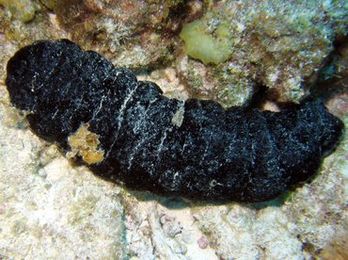
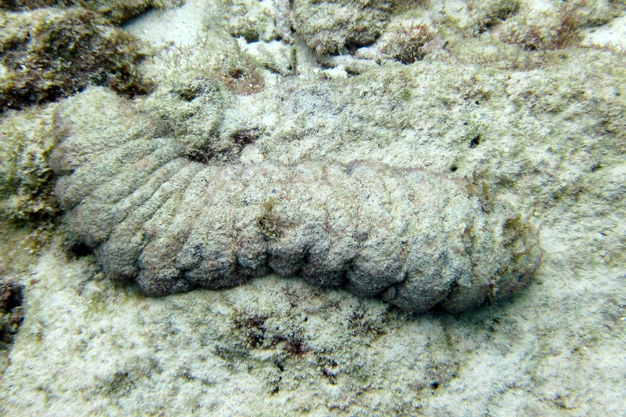
True!
Sea cucumbers such as the “donkey dung” and “green snot” cucumbers are actually a delicacy.

Slide 8
True! Well…Sometimes!
A hermit crab will “mug” a snail to take its shell for protection.
They are mostly opportunists

Slide 9
False!
The man of war jellyfish is the most poisonous jellyfish known to man.
Box Jellyfish

Slide 10
True!
There really are giant squids.
Let’s meet the scientist that found it

Slide 11
How did you do?

